Slide 1
Dancing with Python 101
Yoochan Myung
School of Chemistry and Molecular Biosciences Postdoctoral Research Fellow

Slide 2

Acknowledgement of Country
The University of Queensland (UQ) acknowledges the Traditional Owners and their custodianship of the lands on which we meet.
We pay our respects to their Ancestors and their descendants, who continue cultural and spiritual connections to Country.
We recognise their valuable contributions to Australian and global society.
Image: Digital reproduction of A guidance through time by Casey Coolwell and Kyra Mancktelow
Notes:
Guidelines for use:
Use this slide when presenting at UQ or at any site in Australia, when appropriate.
Remember to pause briefly after acknowledging Country as a sign of respect.
If you are more familiar with acknowledging Country you may add a statement about the event, meeting or forum’s connection with Country. For example, at a higher education event you might acknowledge that the campus has always been a space for teaching, learning, research and collaboration tens of thousands of years before it was established as a university campus, and this continues today.
When to use longer version:
If you are the main speaker at the event/gathering
If you are the first person to present.
When to use a shorter version:
If you are not the first person to acknowledge Country
In a more informal setting
Thanking a Traditional Owner for welcoming people to Country.
Longer version
I acknowledge the Traditional Owners and their custodianship of the lands on which we meet today. On behalf of *, I pay our respects to their Ancestors and their descendants, who continue cultural and spiritual connections to Country. We recognise their valuable contributions to Australian and global society.
* If you are hosting an event, meeting or seminar, you might say something like, “On behalf of the event organisers or your section….”
Shorter version
I (too,) acknowledge the Traditional Owners and their custodianship of the lands on which we meet today and pay my respect to their Ancestors and their descendants.
You may wish to verbally include a line acknowledging the artwork and artists – “We extend our respect and acknowledge sisters and Quandamooka artists Casey Coolwell and Kyra Mancktelow for A guidance through time, the beautiful and powerful representation of reconciliation at UQ.”
Slide last updated February2023. Source: PVC(IE)/ATSISU (contact Nicole Rawson-Harris: uqrap@uq.edu.au).

Slide 3


What’s Python?
A high-level programming language, 1991 (v 0.9.0) ~ current (v 3.11.4)
Free and Open-Source
print(‘Hello, World!’)
01001000 01100101 01101100 01101100 01101111...
high-level language
low-level language
Guido van Rossum
https://en.wikipedia.org/wiki/Python_(programming_language)
https://programmerbay.com/difference-between-high-level-language-and-low-level-language/
3

Slide 4








What’s Python?
Why Python over other languages?
Easy-of-use: great readability and straightforward syntax
Large and active community: a vast community such as scientific computing, machine learning, and web development etc.
Easily get helps via online communities such as Stack overflow, Reddit, StackExchange.
Extensive third-party packages: a rich ecosystem of libraries (further installations are required)
The Python Package Index (PyPI), the official third-party software repository for Python, provides more than 450,000 Python packages.
Pandas for data manipulation and analysis, Scikit-learn for machine learning, NumPy and Scipy for mathematical and scientific computing, and Pytorch for deep learning

Slide 5
What’s Python?
How the Python works?
source code: your code
bytecode: intermediate representation of your code
binary code: two-symbol machine code using “0” and “1"
interpreter
output
source code
compiler
virtual machine
print(‘Hello, World!’)
Hello, World!
b'e\x00d\x00\x83\x01\x01\x00d\x01S\x00'
01001000 01100101 01101100 01101100 01101111...
print() is a built-in Python functions
Python bytecode (.pyc)
binary code
https://towardsdatascience.com/how-does-python-work-6f21fd197888

Slide 6
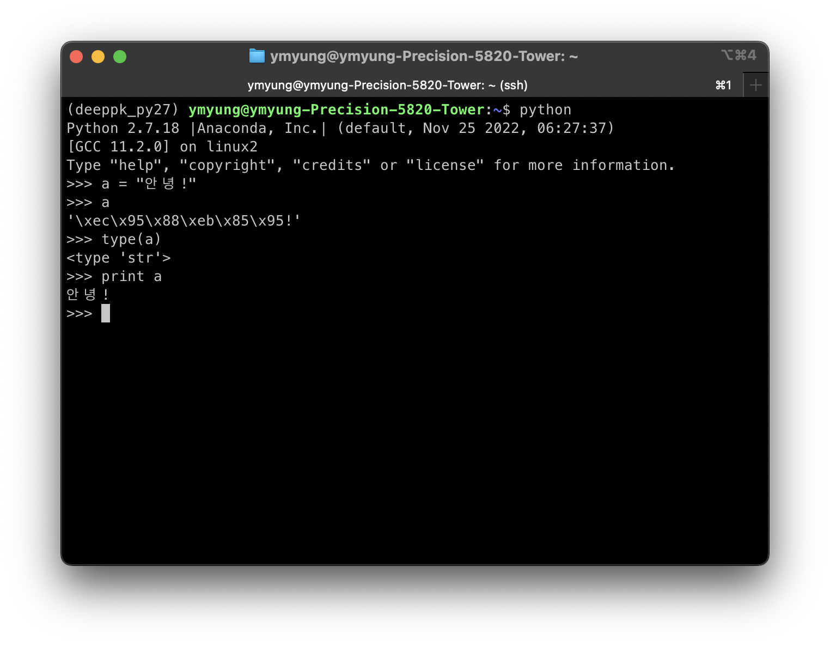
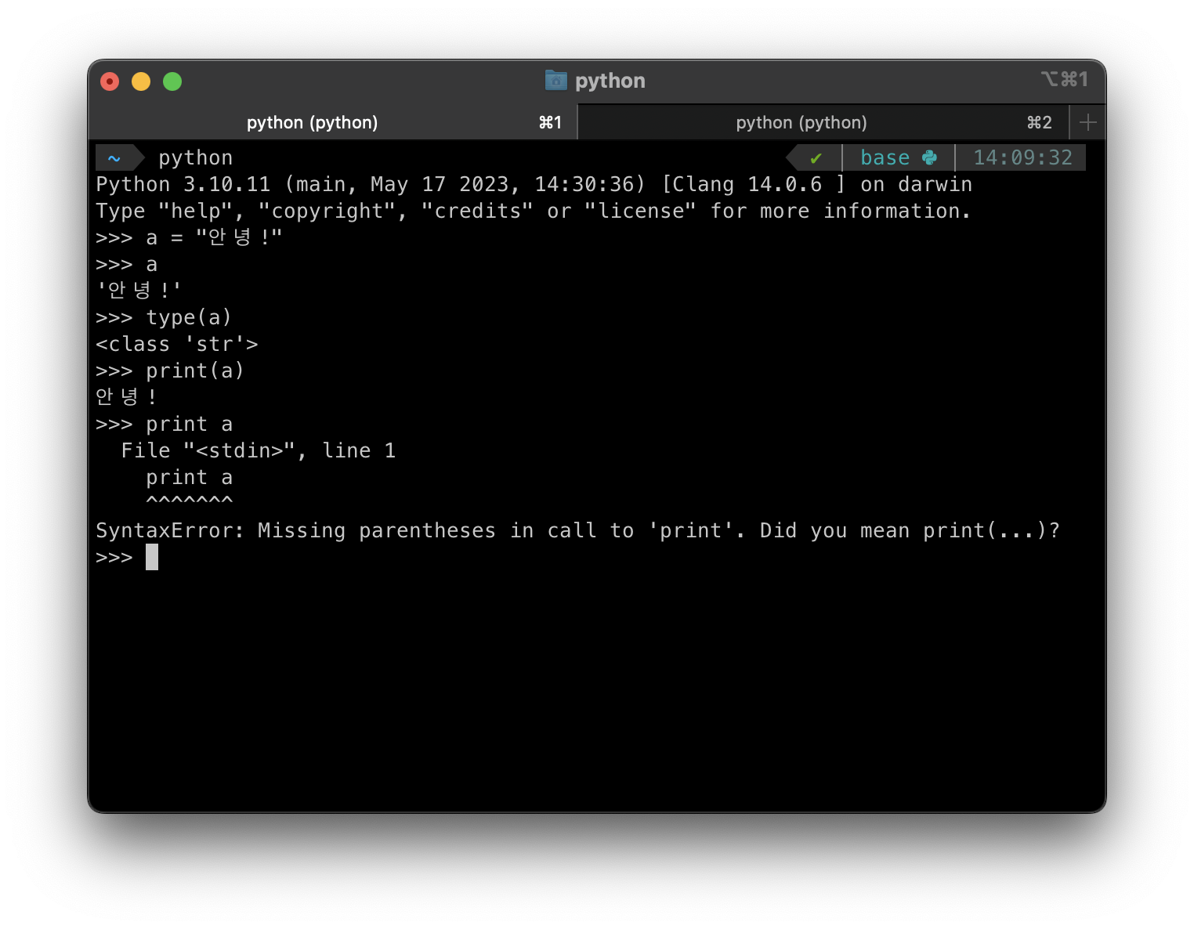
What’s Python?
Python 2 vs Python 3
Dropped support for Python 2 in 2020.
For storage of strings, Python 2 uses ASCII and Python 3 uses UNICODE.
In Python2, “Print” is a statement not a function.
Converting Python 2 codes to Python 3 may need a lot of effort due to the incompatibility above.
안녕! = Hello!
“Consider the third-party packages you intend to use. If none are required, stick with the latest versions available.”

Slide 7
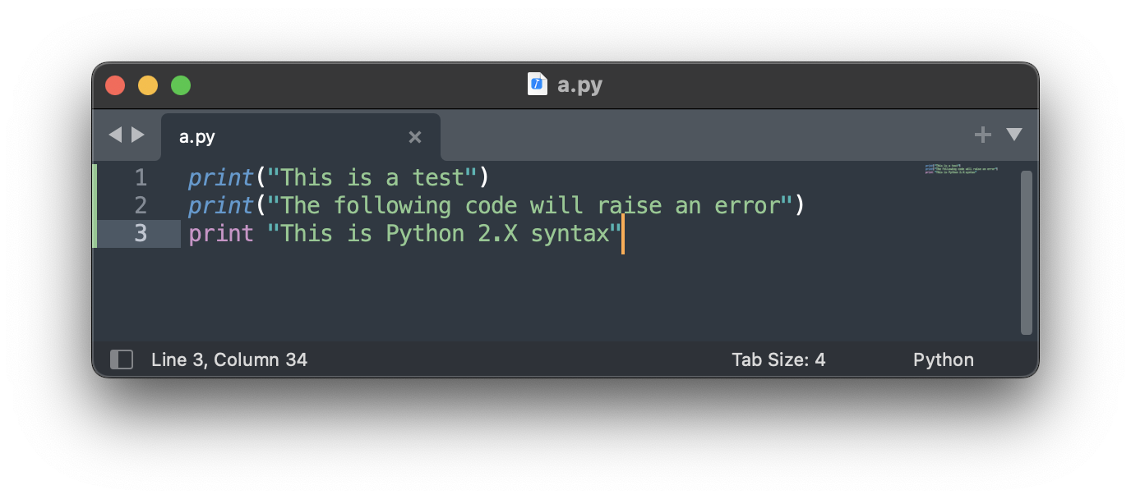
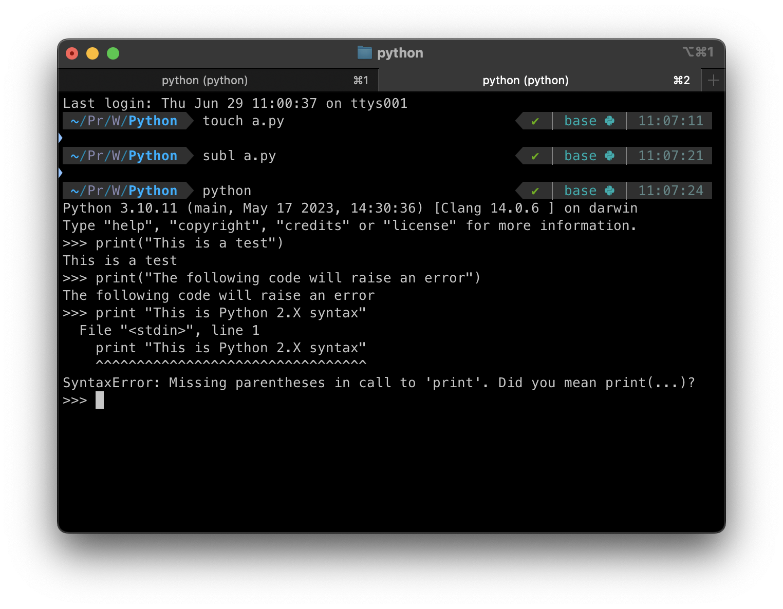
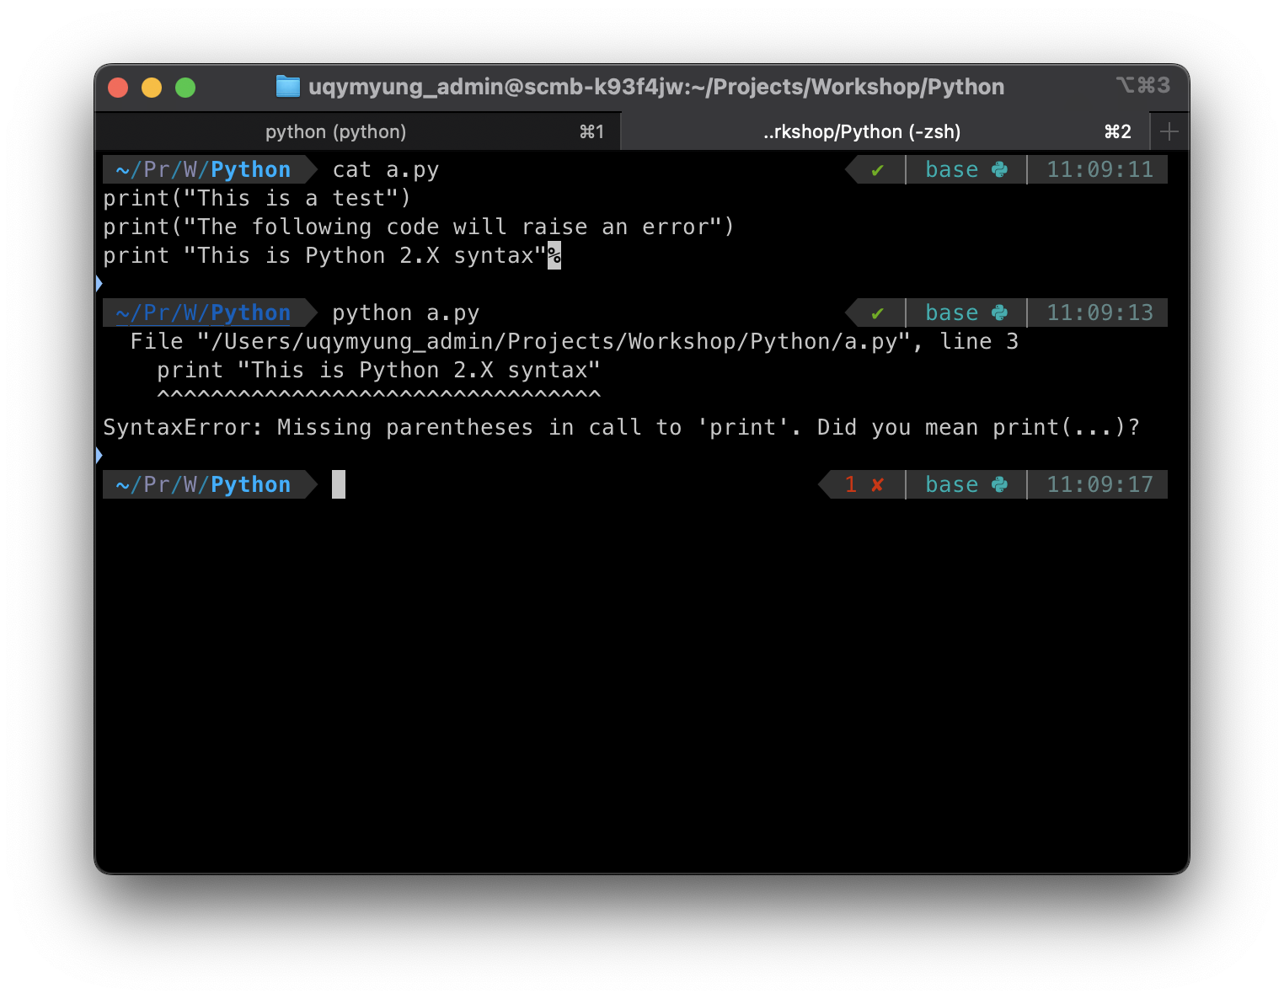
How to start coding?
via Python file execution
via Python IDLE* (console)
real time,
one-by-one,
easier to experiment, test small code segments
faster,
more limited to debugging,
better to write long codes
*Integrated Development and Learning Environment

Slide 8



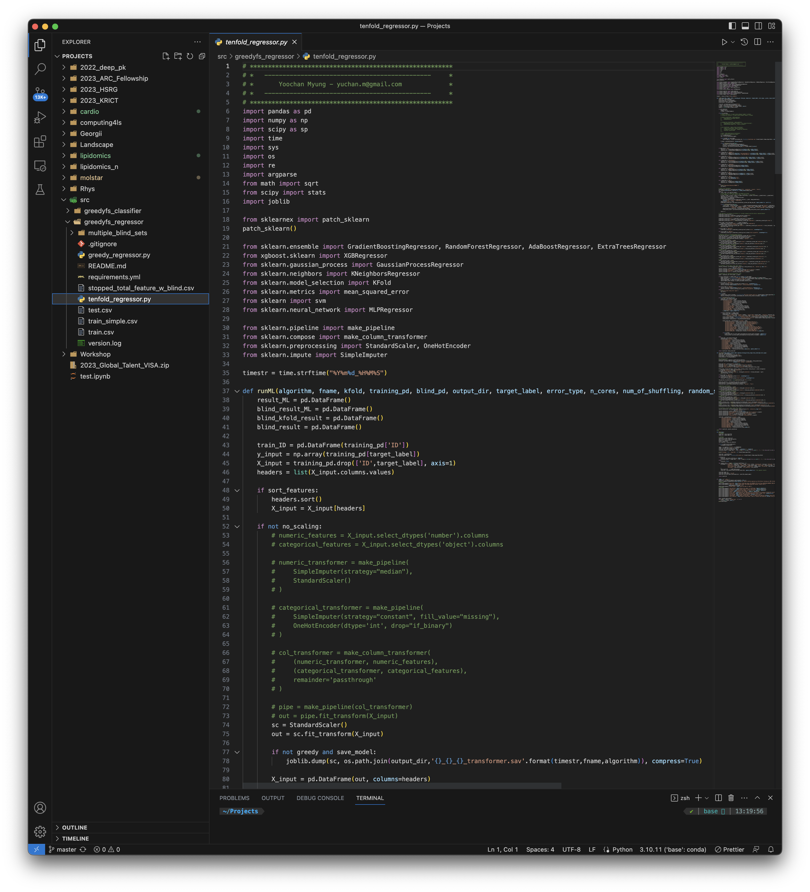
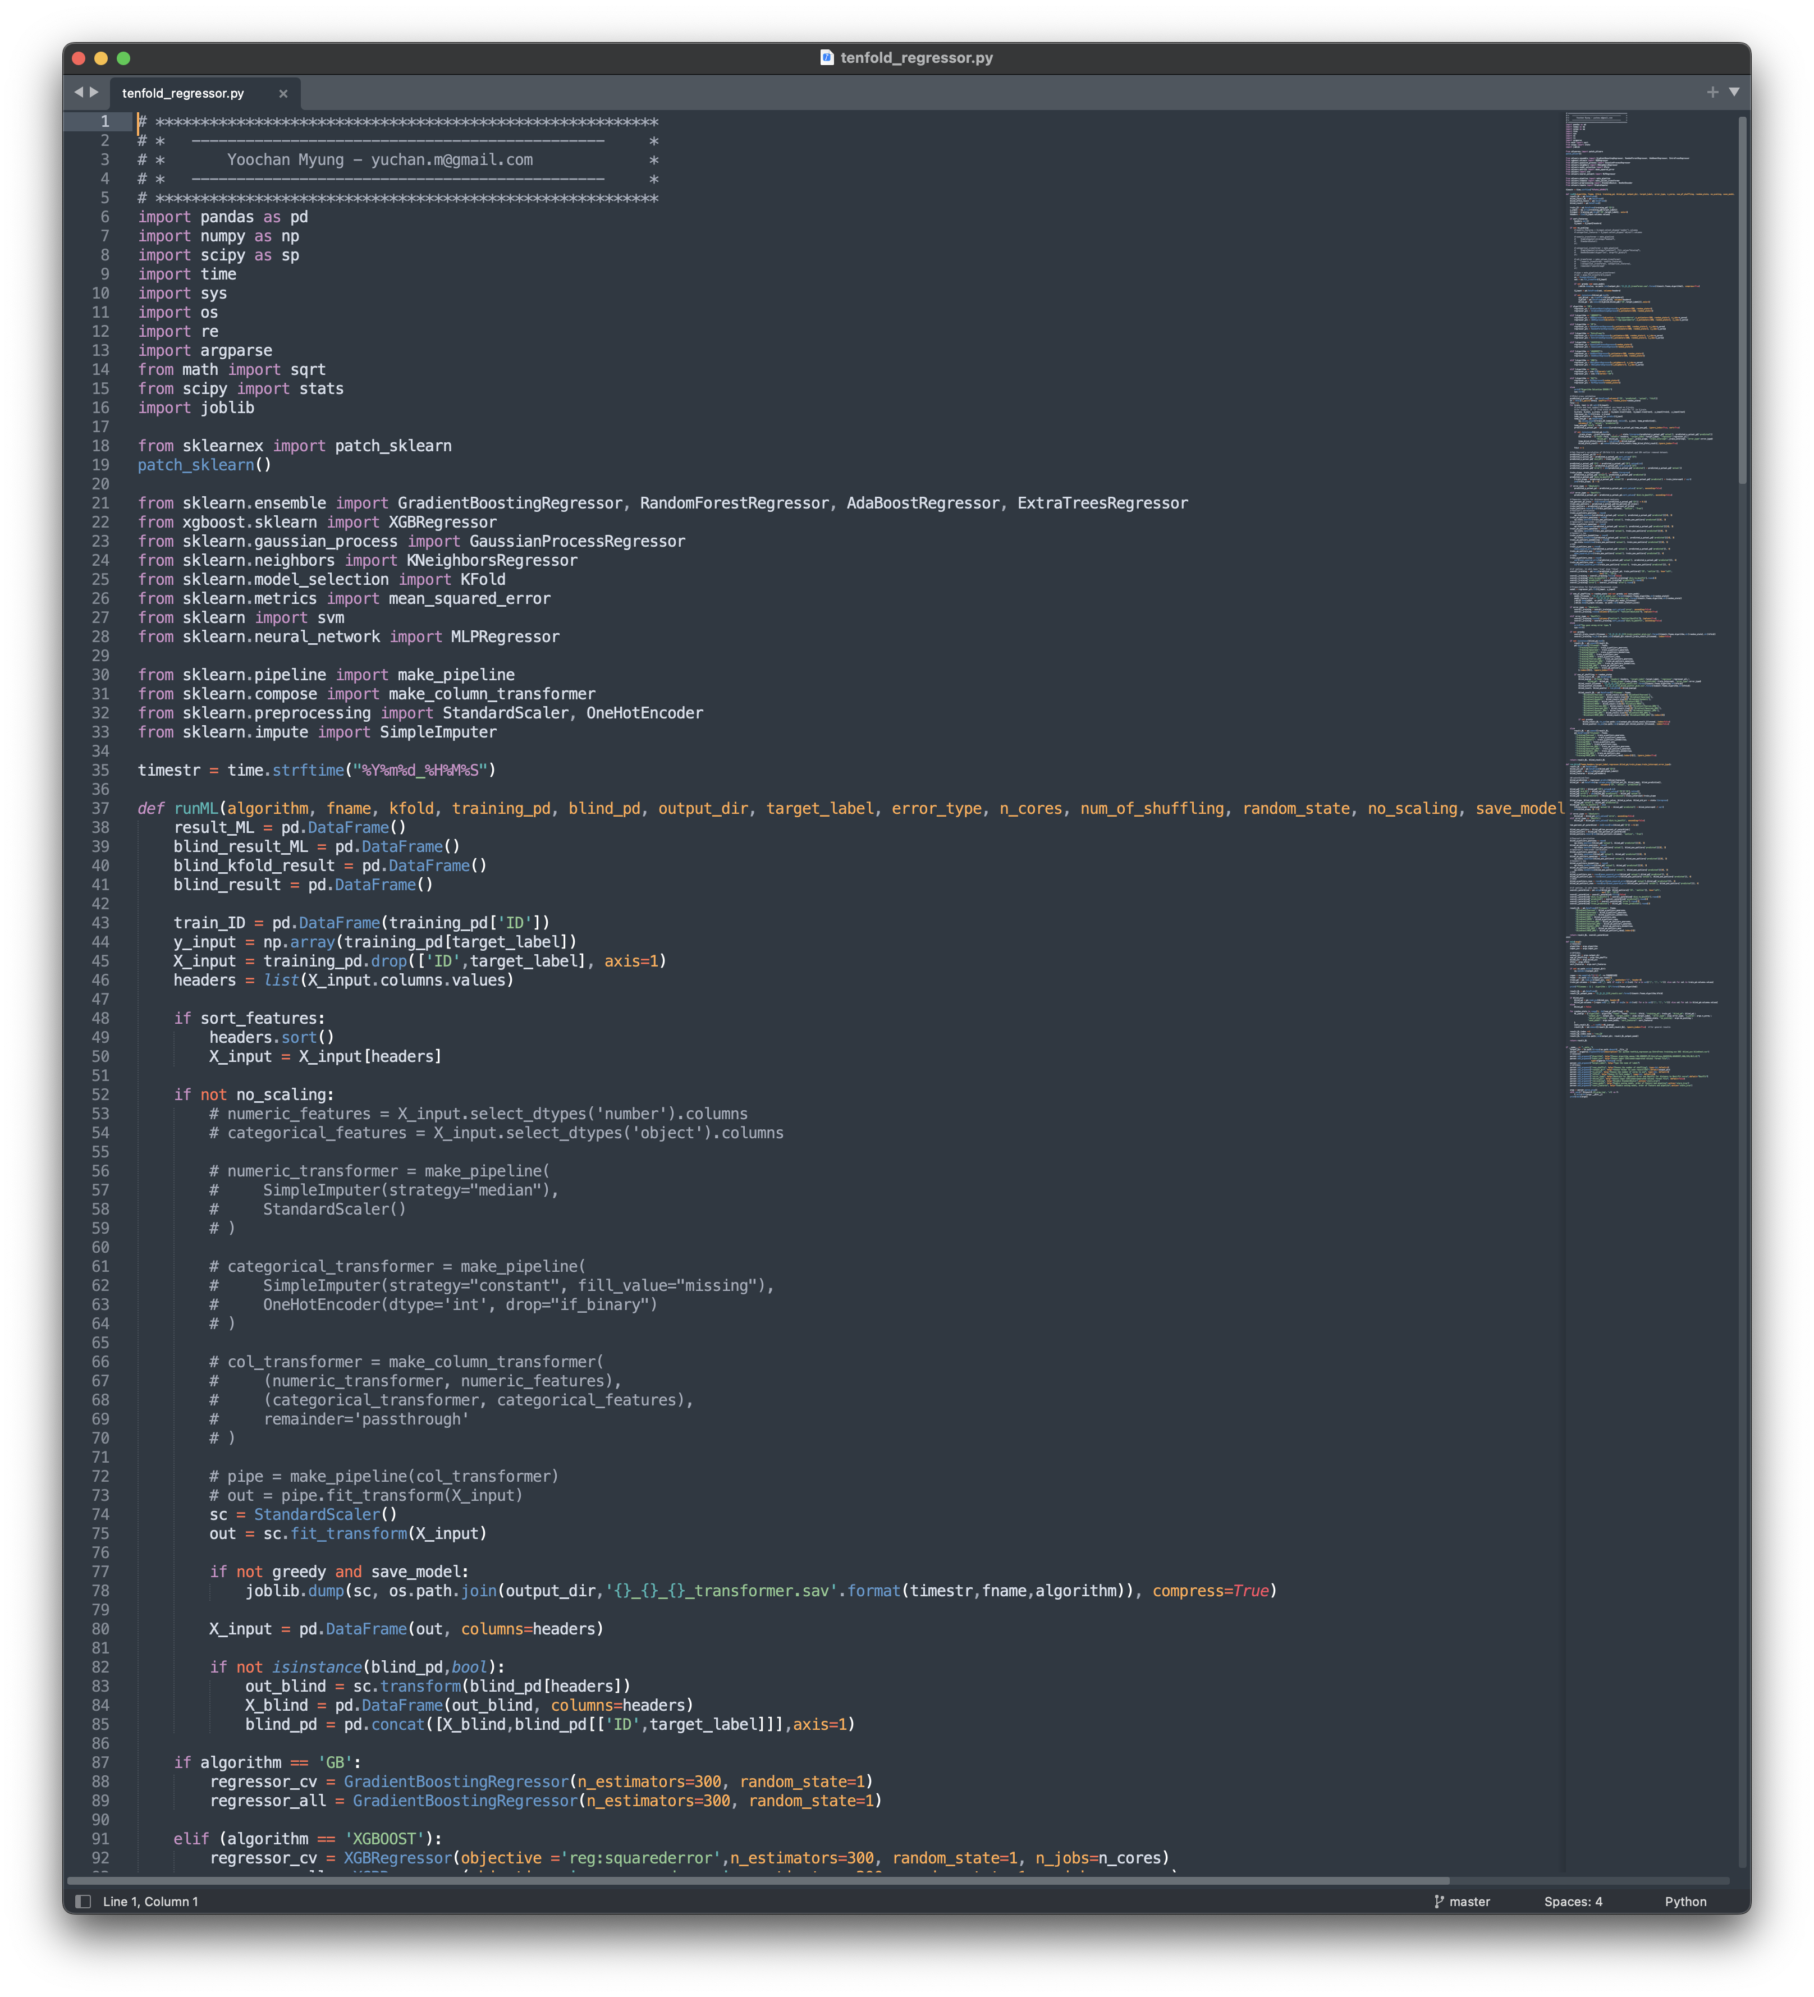
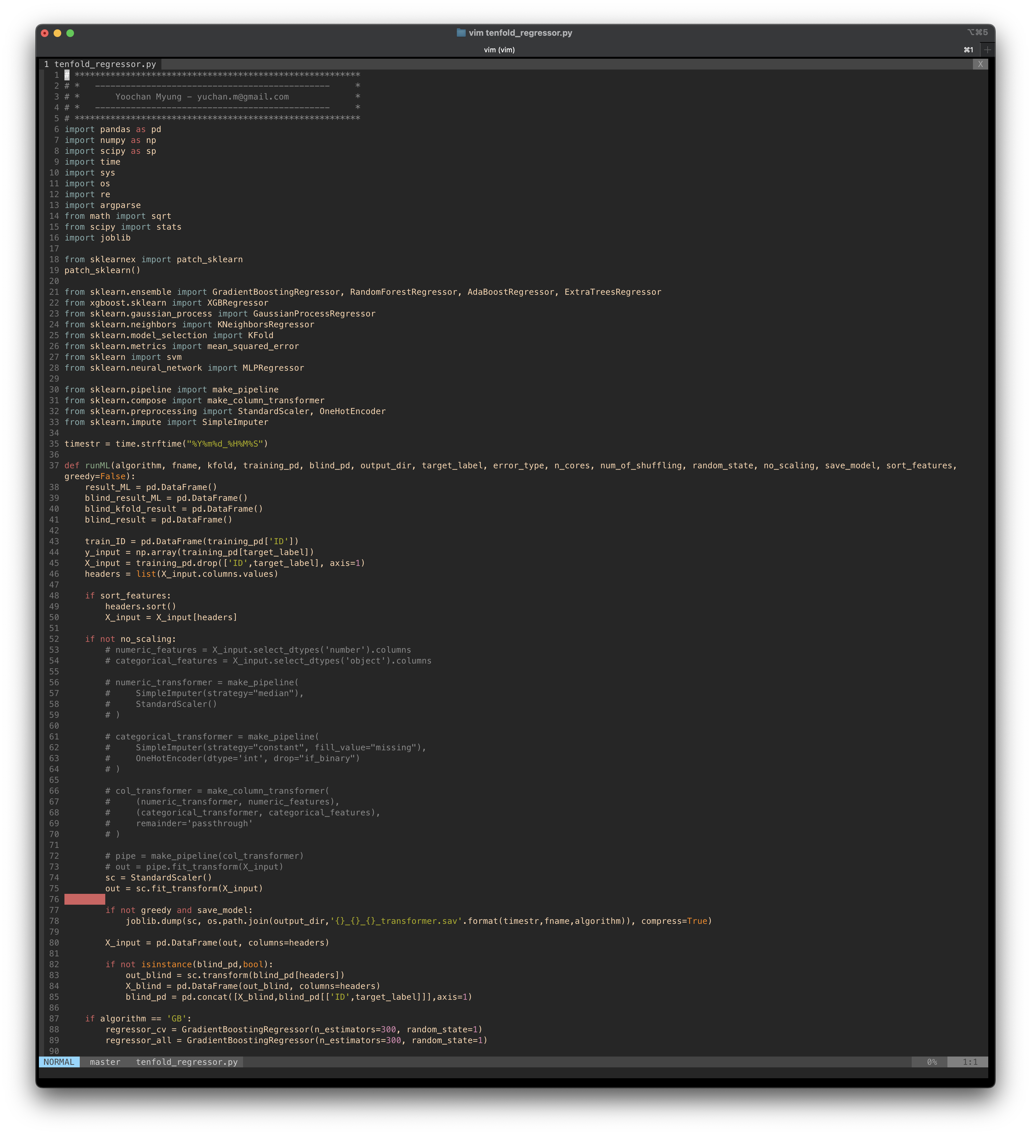
Integrated Development Environment (IDE):
Syntax highlighting
Debugging
Integrated Terminal
...
Visual Studio Code
Sublime text
Vim

Slide 9


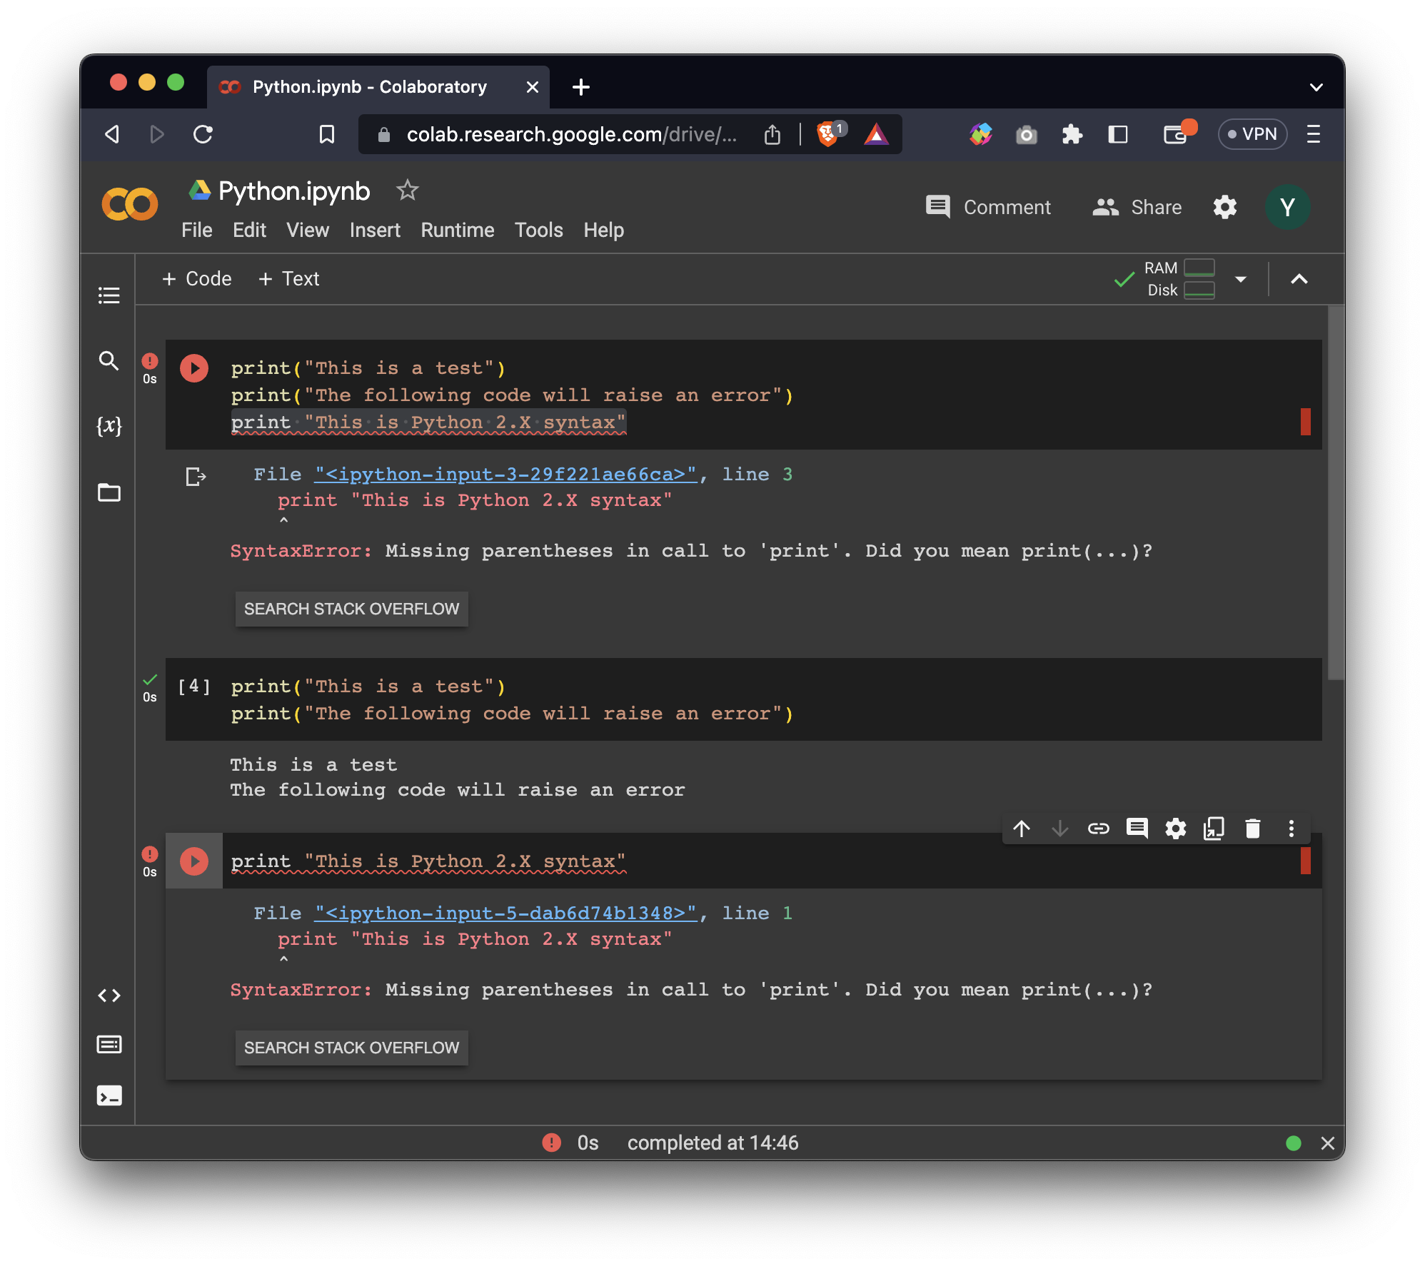
Jupyter Notebook
A unique combination of interactive code execution, documentation and data analysis features.
Run on Google CoLab server
Easy to share and less compatibility issues
Notes:
https://colab.research.google.com/drive/1QuoyyEUAHkgEoYna_7KlCZO-g3CzSsqQ?usp=sharing

Slide 10
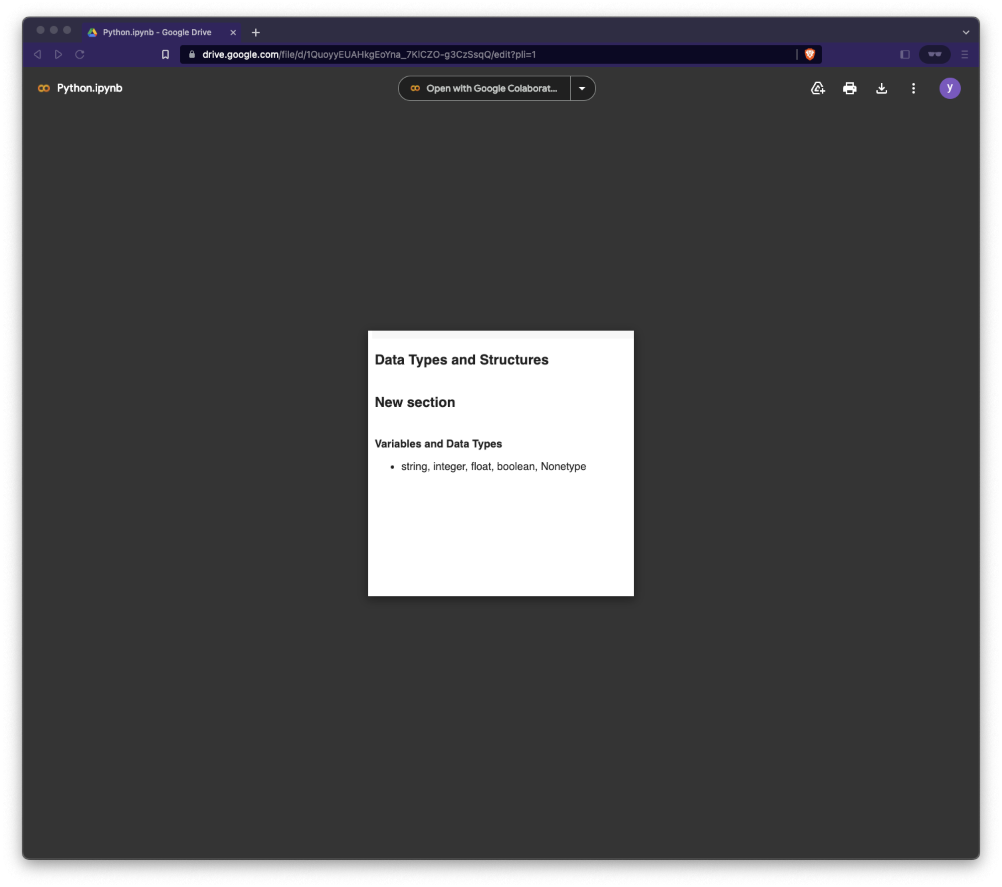
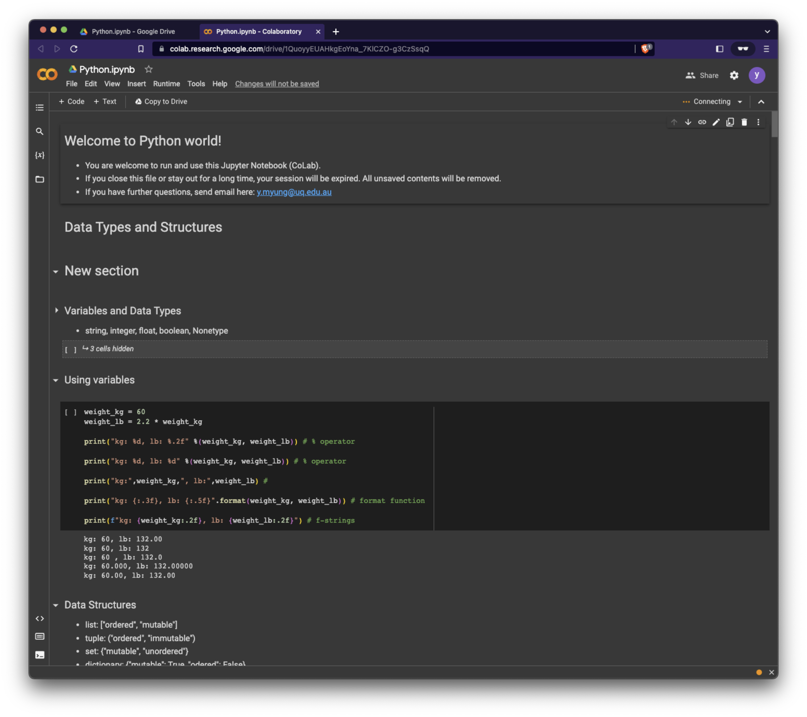
How to use Google CoLab
This will create a Python.ipynb in your Google Drive storage.
Don’t worry, it’s a copy of the original Python.ipynb and saving from your files will NOT affect to the original file.

Slide 11
TIME FOR A BREAK
Please be ready for using Google CoLab and ChatGPT!
https://shorturl.at/hKOZ5
https://openai.com/blog/chatgpt

Slide 12
Python Data Types and Structures
“Hello”
1.61
[1, 2, 1, “hi”, 4.44, “5”, None, True, None]
(1, 2, 1, “hi”, 4.44, “5”, None, True, None)
None
{“first name”: “Yoochan”, “last name”: “Myung”}
1523
True
{1, 2, 4.44, “hi”, None, “5”}

Slide 13
Python Variables and Data Types
Variables: we need to assign (=) our data (“Hello, World!”) to a variable (v1).
can contain letters, digits and underscores(_).
Case-sensitive (v1 ≠ V1)
First character must be letter or an underscore(_).
Cannot use Python reserved keywords as variable names
Types of data
integer number: 1, 10, 100
floating point number: 3.14
string: “Hi”, “1”, “3.14”
boolean: True (1), False (0)
Nontype: None
reserved keywords
built-in functions
False, class, finally, is, return
None, continue, for, lambda, try
True, def, from, nonlocal, while
and, del, global, not, with
as, elif, if, or, yield
assert, else, import, pass
break, except, in, raise
list, set, dict, tuple, str, int, float, bool
“Hello”
1.61
None
1523
True

Slide 14
Python Variables and Data Types
Q1. Assign the five data types into different variables.
Q2. Print the variables and their types using `print()` and `type()`.
“Hello, World!”
1.23
None
123
True

Slide 15
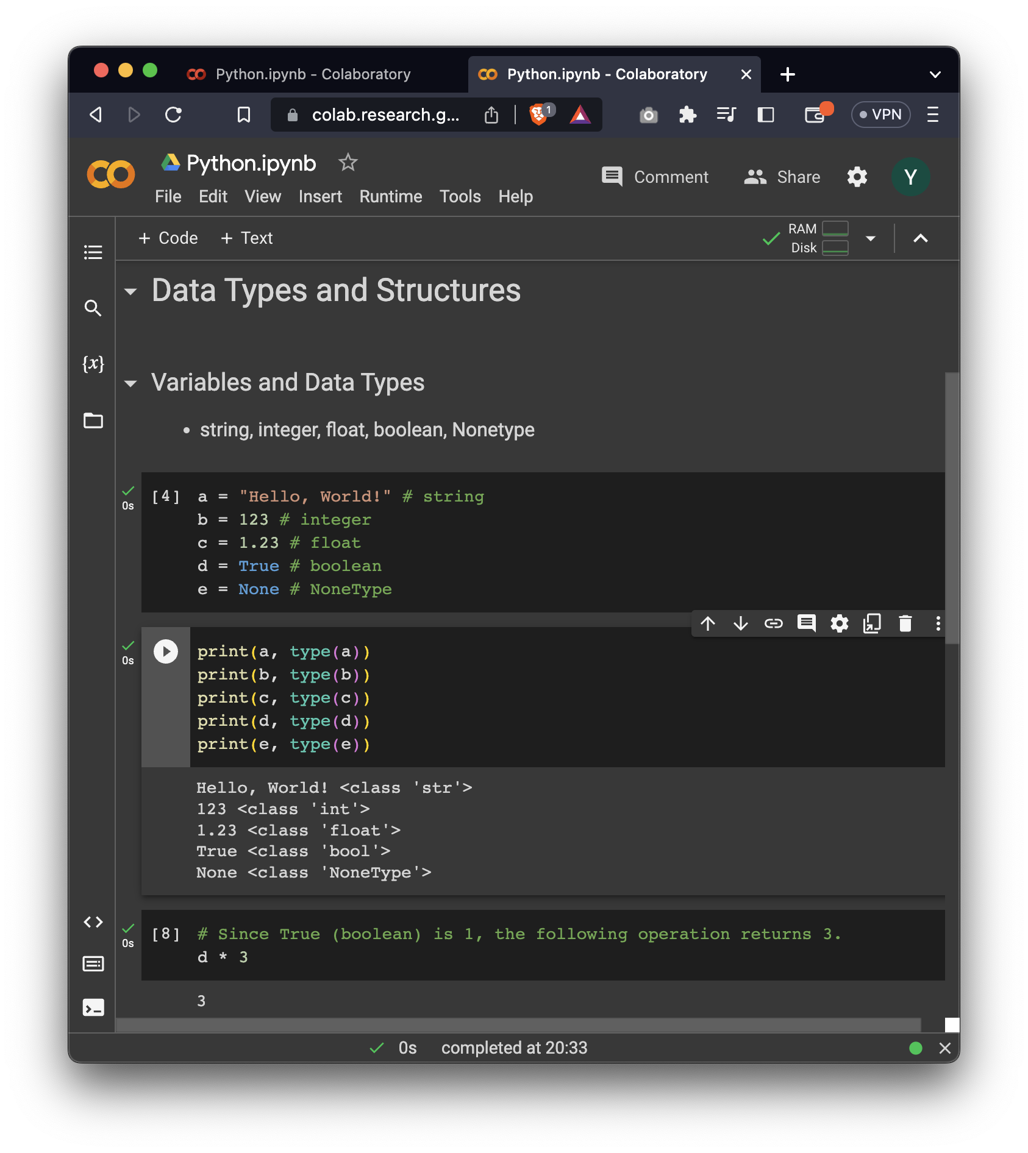
Python Variables and Data Types
Q1. Assign the five data types into different variables.
Q2. Print the variables and their types using `print()` and `type()`.
“Hello, World!”
1.23
None
123
True

Slide 16
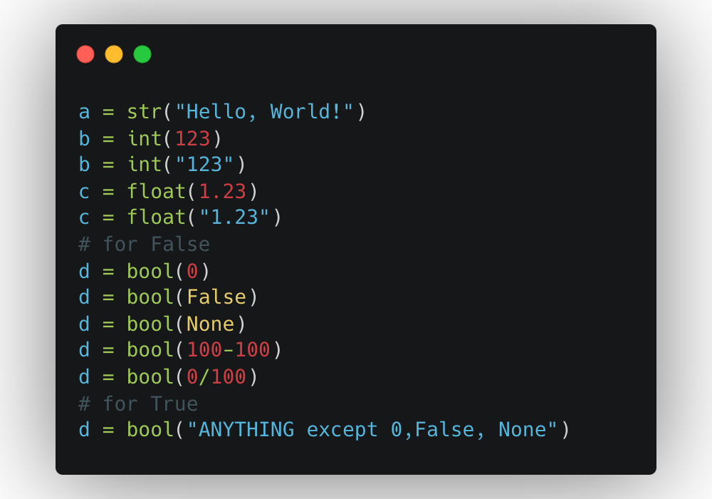
Python Variables and Data Types
Q1. Assign the five data types into different variables.
Q2. Print the variables and their types using `print()` and `type()`.

Slide 17
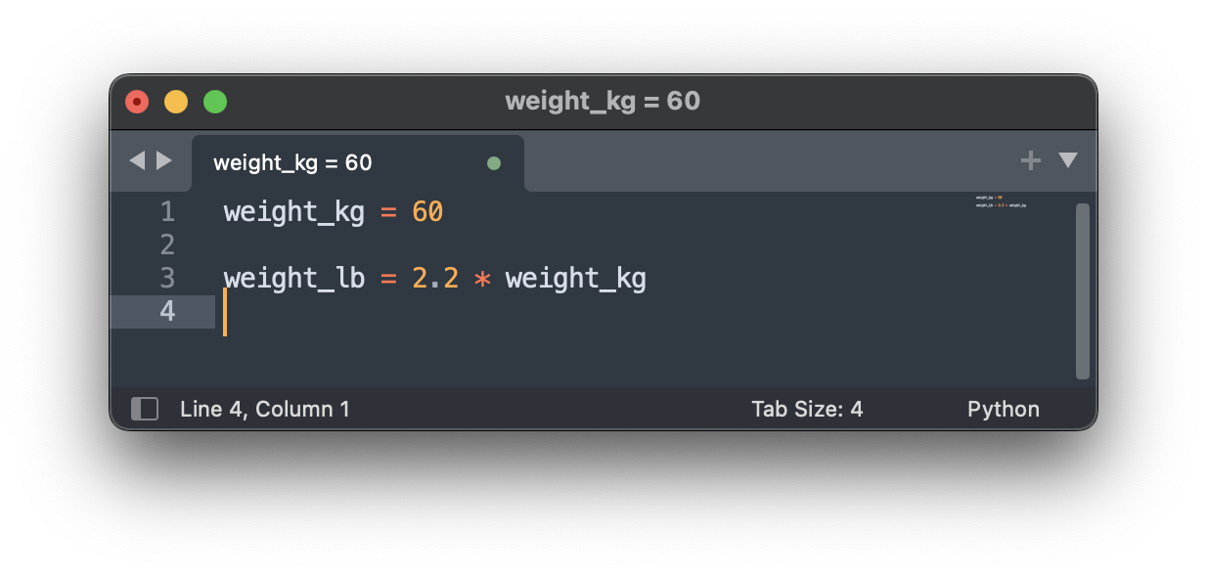
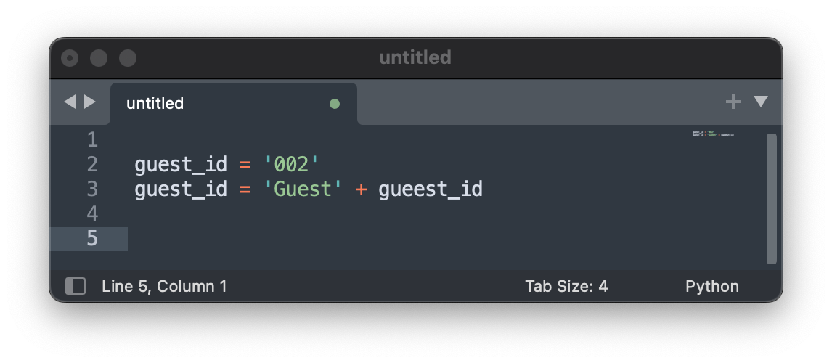
Python Variables and Data Types
Using operators with data types
Try operators (+, -, /, *) with the five variables.
Q3. What combinations of operators and operands are valid?

Slide 18
Python Variables and Data Types
Using operators with data types
Try operators (+, -, /, *) with the five variables.
Q3. What combinations of operators and operands are valid?
‘int or float’ and ‘int or float’ : +, -, /, *
‘str’ and ‘str’: +
‘str’ and ‘int’: *
`int or float` and `bool` : +, -, *, / (except division by False (0))
because True == 1, False == 0

Slide 19
Python Variables and Data Types
Numeric Types – int, float and complex
Operation | Meaning | Result
1 + 4 | sum | 5
1 – 4 | difference | -3
1 * 4 | product | 4
1 / 4, 11 / 5 | quotient of 1 and 4 | 0.25, 2.2
1 // 4, 11 // 5 | floored quotient of 1 and 4 | 0, 2, 2
1 % 4 | remainder of 1 / 4 | 1
abs(-4) | absolute | 4
int(3.14), int(3.9) | convert to integer | 3
float(3) | convert to floating point | 3.0
pow(2,3) | 2 to the power 3 | 8
2 ** 3 | 2 to the power 3 | 8

Slide 20
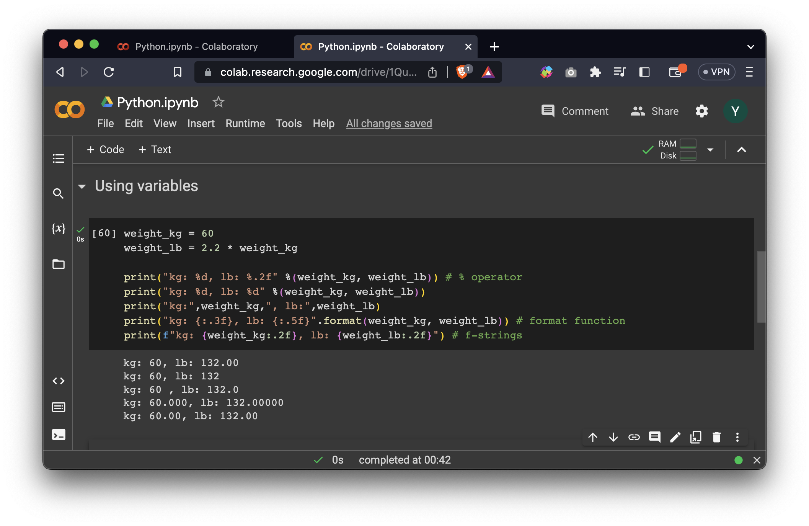
Python Variables and Data Types
Python String Formatting
The basic `print()` function does not provide direct control over the decimal point precision of floating-point numbers.
% operator:
`%s` for string, `%d` for integer and `%f` for float.
`format()` : since Python 3.0
f-strings: since Python 3.6
- `{:d}` for integer, `{:f}` for a floating-point number with two decimal places
{:.2f}
`:` the start of the format specifier
`2` specifies the precision or the number of decimal places to display
`f` the type specifier for floating-point numbers

Slide 21
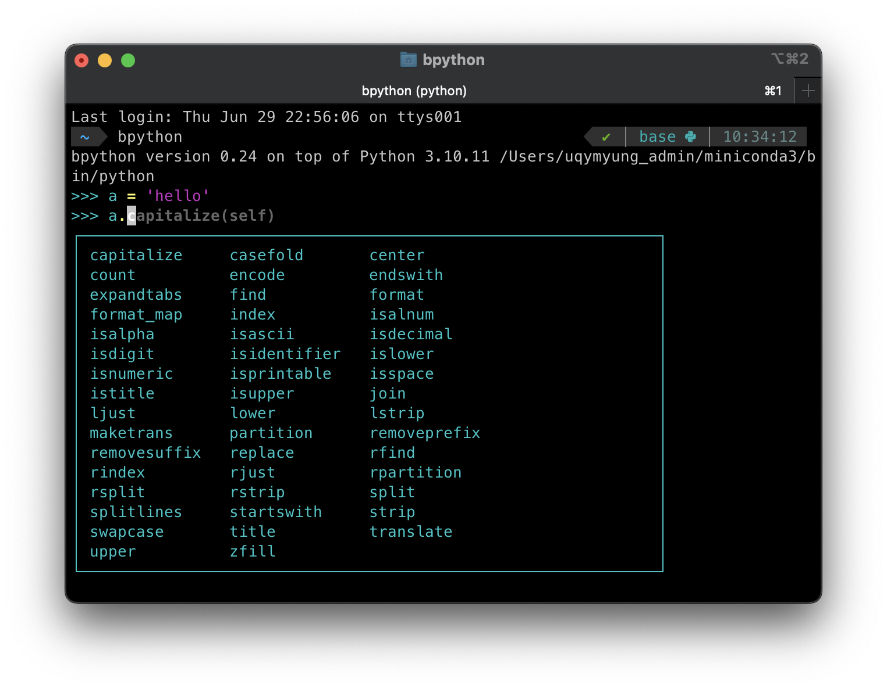
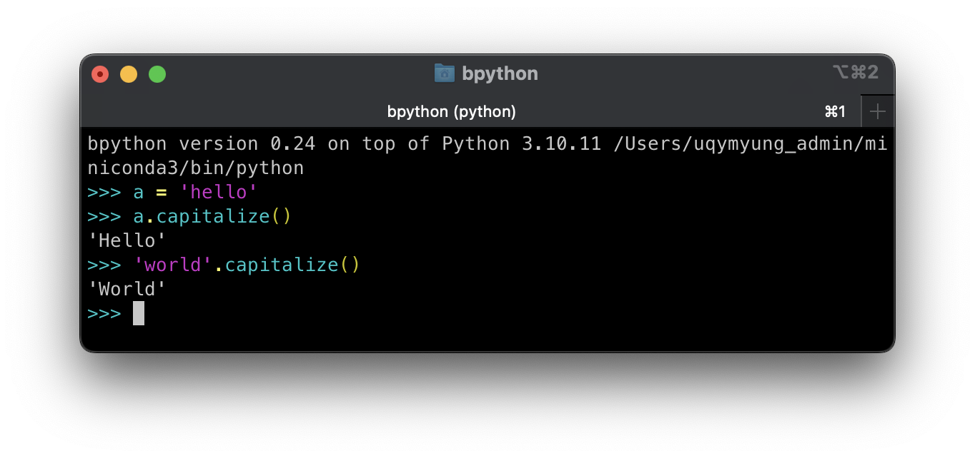
String functions
function | example | output
str.capitalize(self) |  | Hello
str.upper(self) |  | HELLO
str.lower(self) |  | hello
str.count(obj, sub[, star[, end]]) | str.count(‘l’) str.count(‘l’, 4) | 2 1
str.isalpha(self) |  | True
str.isnumeric(self) |  | False
str.strip(self, chars) |  | hello
str.lstrip(self, chars) | str.lstrip(‘h’) | ello
str.rstrip(self, chars) | str.rstrip(‘h’) | hello
str.startswith(obj, [, start[, end]]) | str.startswith(‘h’) | True
str.endswith(obj, [, start[, end]]) | str.endswith(‘h’) | False
str.replace(self, old, new, count) | str.replace(‘l’,’a’,2) | heaao
Q4. Test str.isalpha() on ‘hello’, ‘hello!’, ‘hell0’, and ‘ hello’.

Slide 22
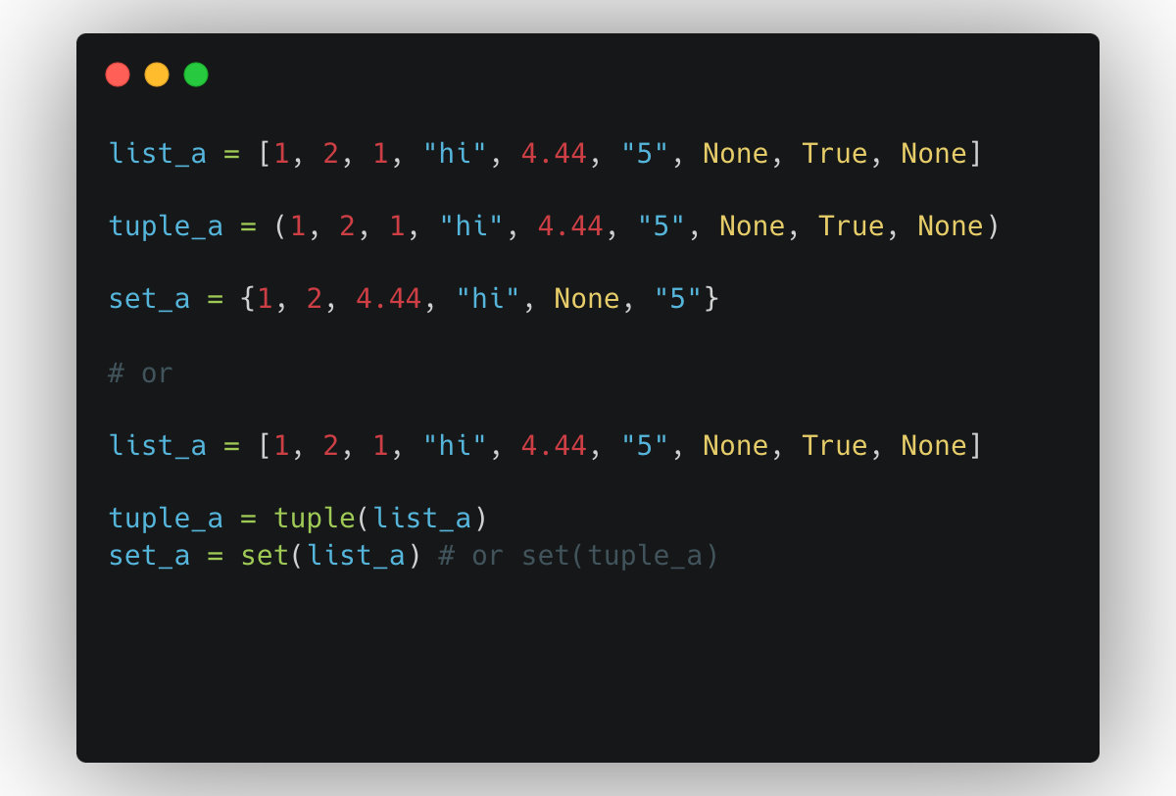
Python Data Structures
List: ordered and mutable collections of elements
[1, 2, 1, ”hi”, 4.44, “5”, None, True, None]
Tuple: ordered and immutable collections of elements
(1, 2, 1, “hi”, 4.44, “5”, None, True, None)
Set: unordered and mutable collections of unique elements
{1, 2, 4.44, “hi”, None, “5”}
Q5. What happens if you convert a list, ["True", True, False, 1, 0] to a set using `set()`?

Slide 23
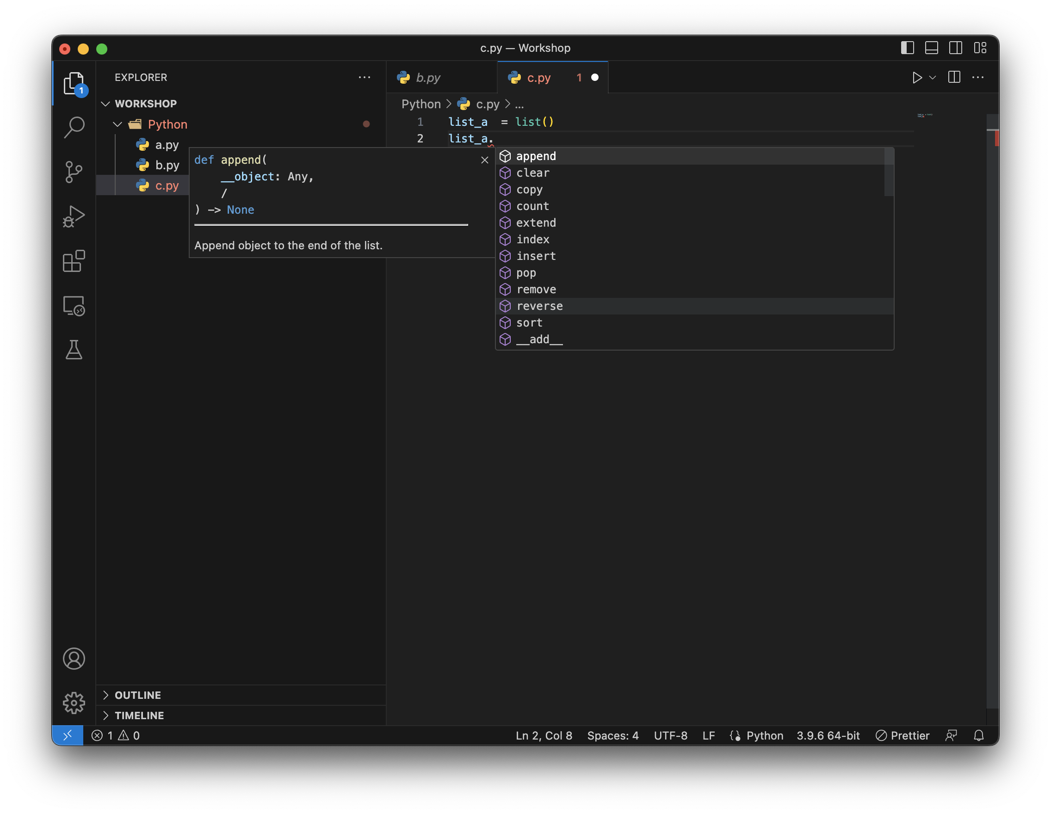
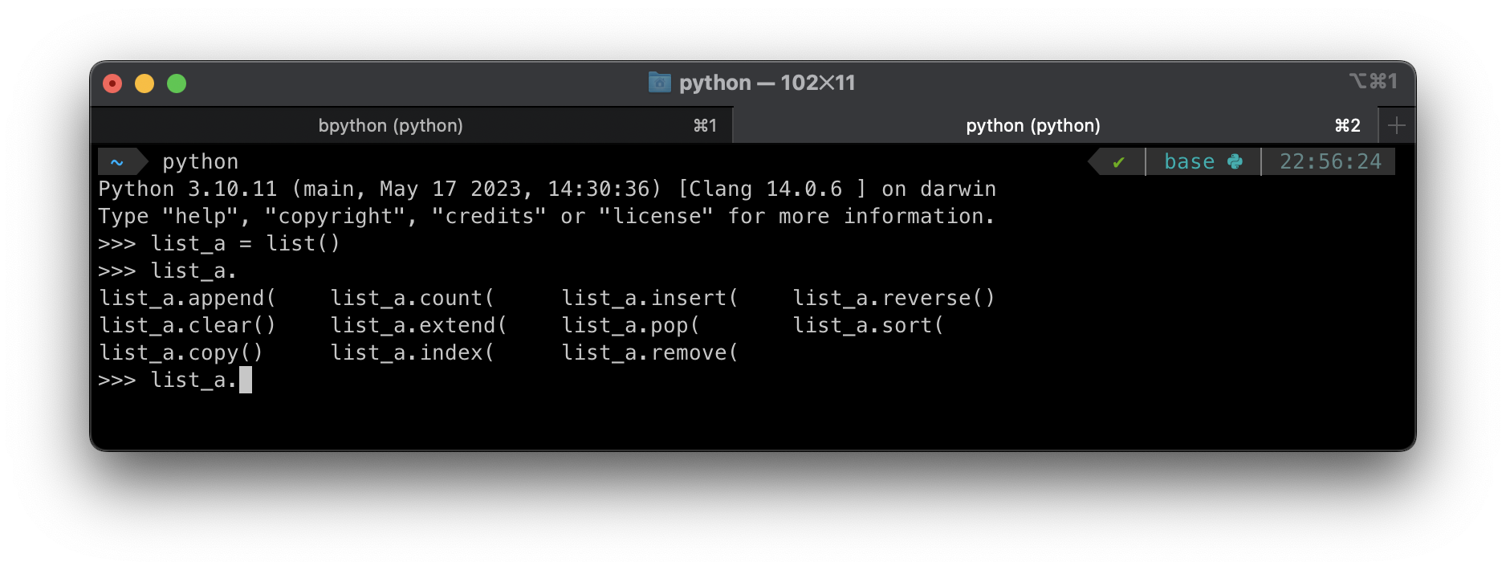
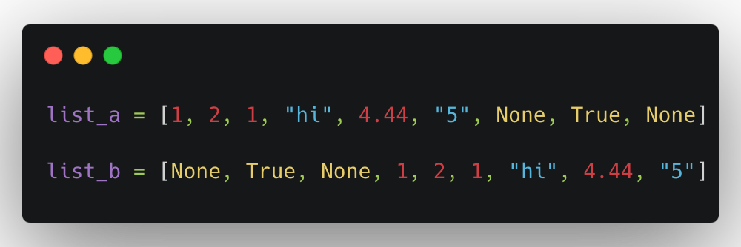
List
List is a mutable and ordered sequence class.
Mutable and immutable classes have some common functions.
`append(self, object)`: Append object to the end of the list.
`extend(self, iterable)`: Extend list by appending elements from the iterable.
`insert(self, index, object)`: Insert object before index
`clear(self)`: Remove all items from list.
`index(self, value, start, stop)`: Return first index of value or ValueError if the value is not present.
`remove(self, value)`: Remove first occurrence of value or raise ValueError if the value is not present.
`sort(self, *, key=None, reverse=False)`: Sort the list in ascending order
Q6. What’s the difference between append and extend?

Slide 24
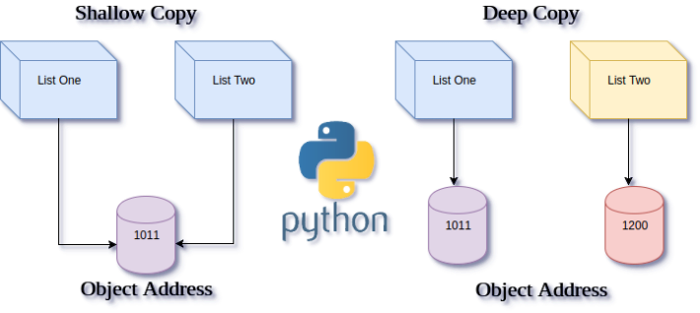
List
Q7. What happens if the built-in functions are used as variables?
How to copy a list object?
Using `=` operator [assigning]
Using `list.copy()` [shallow copy]
Using `copy` module [deep copy]
built-in functions
list, set, dict, tuple, str, int, float, bool
A shallow copy in Python creates a new object that references the original elements of the copied object.
When you have a list of lists and create a shallow copy, it copies the references of the inner lists rather than creating new independent copies. As a result, changes made to the values within the inner lists will be reflected in both the original list and the shallow copy.
???
https://www.i2tutorials.com/what-is-the-difference-between-deep-and-shallow-copy/

Slide 25
Range
Produces a sequence of integers from start (inclusive) to stop (exclusive) by step.
range(stop) or range(start, stop[, step])
range(i, j) or range(i, j, 1) produces i, i+1, i+2 ,..., j-1
list(range(0, 4)) = [0, 1, 2, 3]
list(range(4)) = [0, 1, 2, 3]
list(range(0, 4, 1)) = [0, 1, 2, 3]
This works only with integers, doesn’t not support float type. (Use `numpy.arange()`)

Slide 26
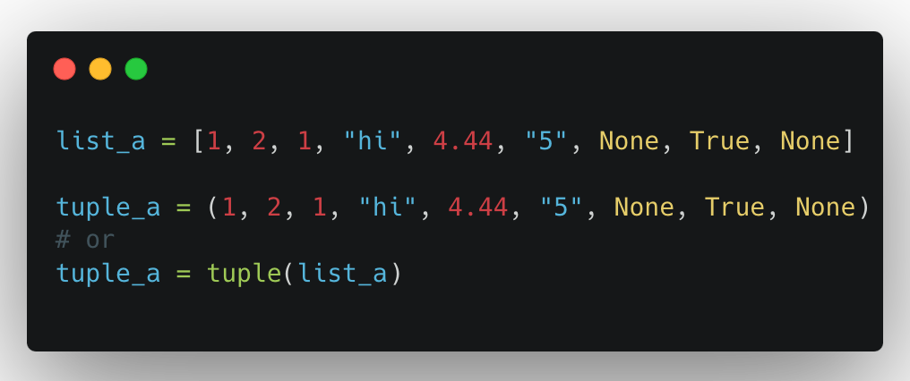
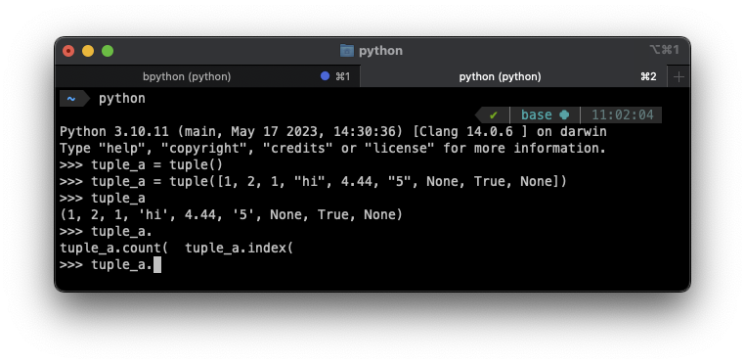
Tuple
Tuple is an immutable sequence class.
`count(self, value)`: Return number of occurrences of value.
`index(self, value, start, stop)`: Return first index of value.
Q8. Can we add elements to an existing tuple?
https://docs.python.org/3/library/stdtypes.html?highlight=list#tuples

Slide 27
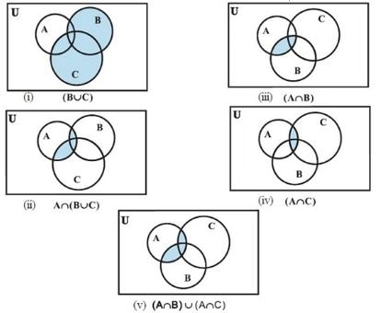
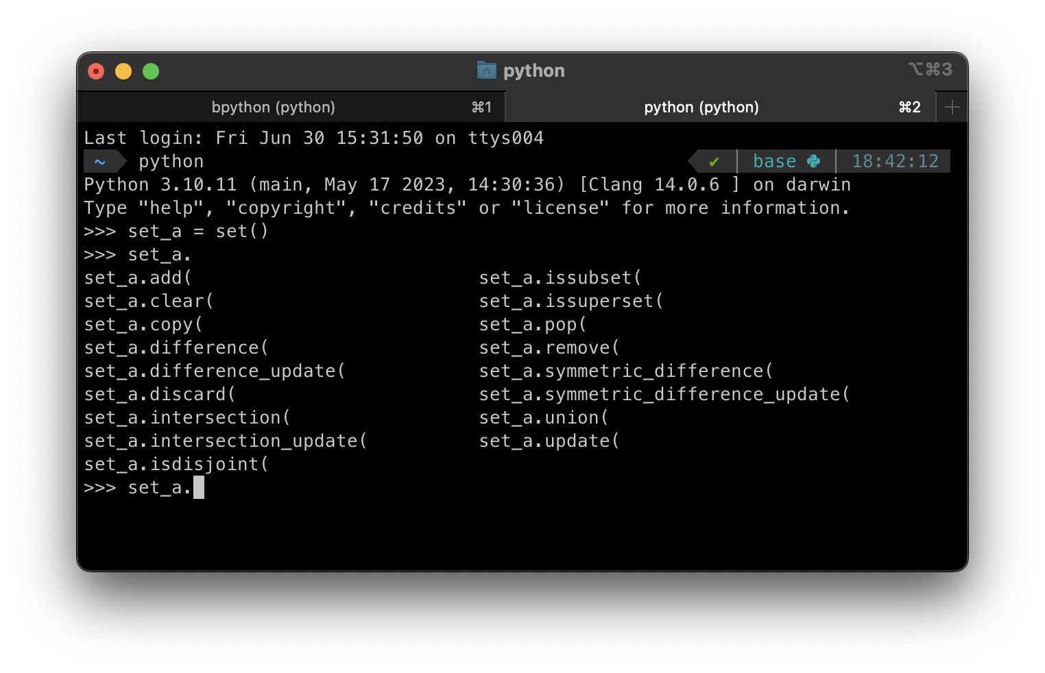
Set
Set is an unordered collection of distinct hashable objects.
Hash value: `hash(object)` returns an integer that is unique to the object.
Same hash values → same objects.
This can be used for data lookup, data integrity checks and object uniqueness testing.
The hash() function generates a hash value based on the contents of an object, while the id() function returns a unique identifier based on the memory address of an object.
https://guidancecorner.com/set-theory/
Notes:
https://guidancecorner.com/set-theory/

Slide 28
Set
Set is an unordered collection of distinct hashable objects. Q9. What is the hash value of ‘A’ and ‘a’?
set_A.union(set_B) = set_A | set_B
set_A.difference(set_B) = set_A – set_B
set_A.intersection(set_B) = set_A & set_B
set_A.issubset(set_B) = set_A <= set_B
set_B.issuperset(set_A) = set_A <= set_A
set_A.symmetric_difference(set_B) = set_A ^ set_B
Hash value: `hash(object)` returns an integer that is unique to the object.
Same hash values → same objects.
This can be used for data lookup, data integrity checks and object uniqueness testing.
Notes:
https://guidancecorner.com/set-theory/

Slide 29
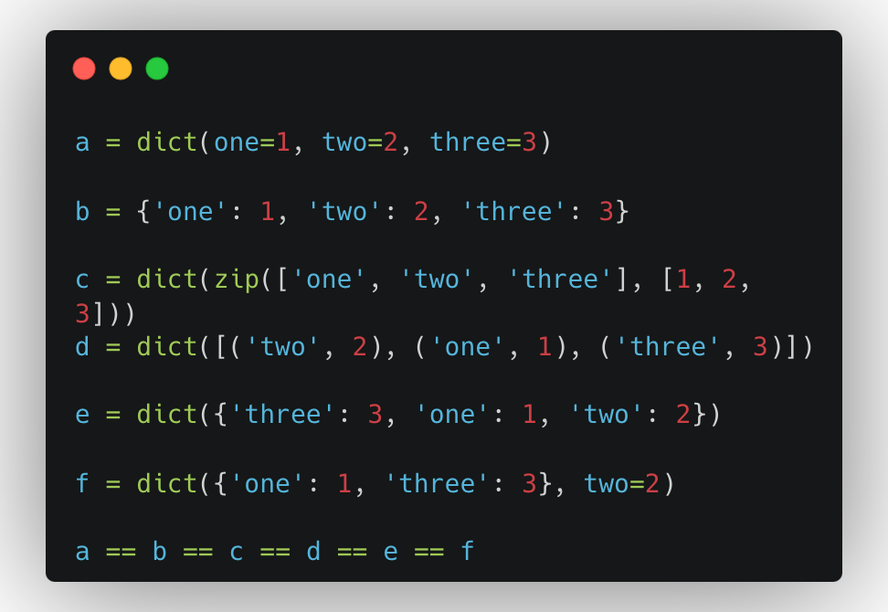
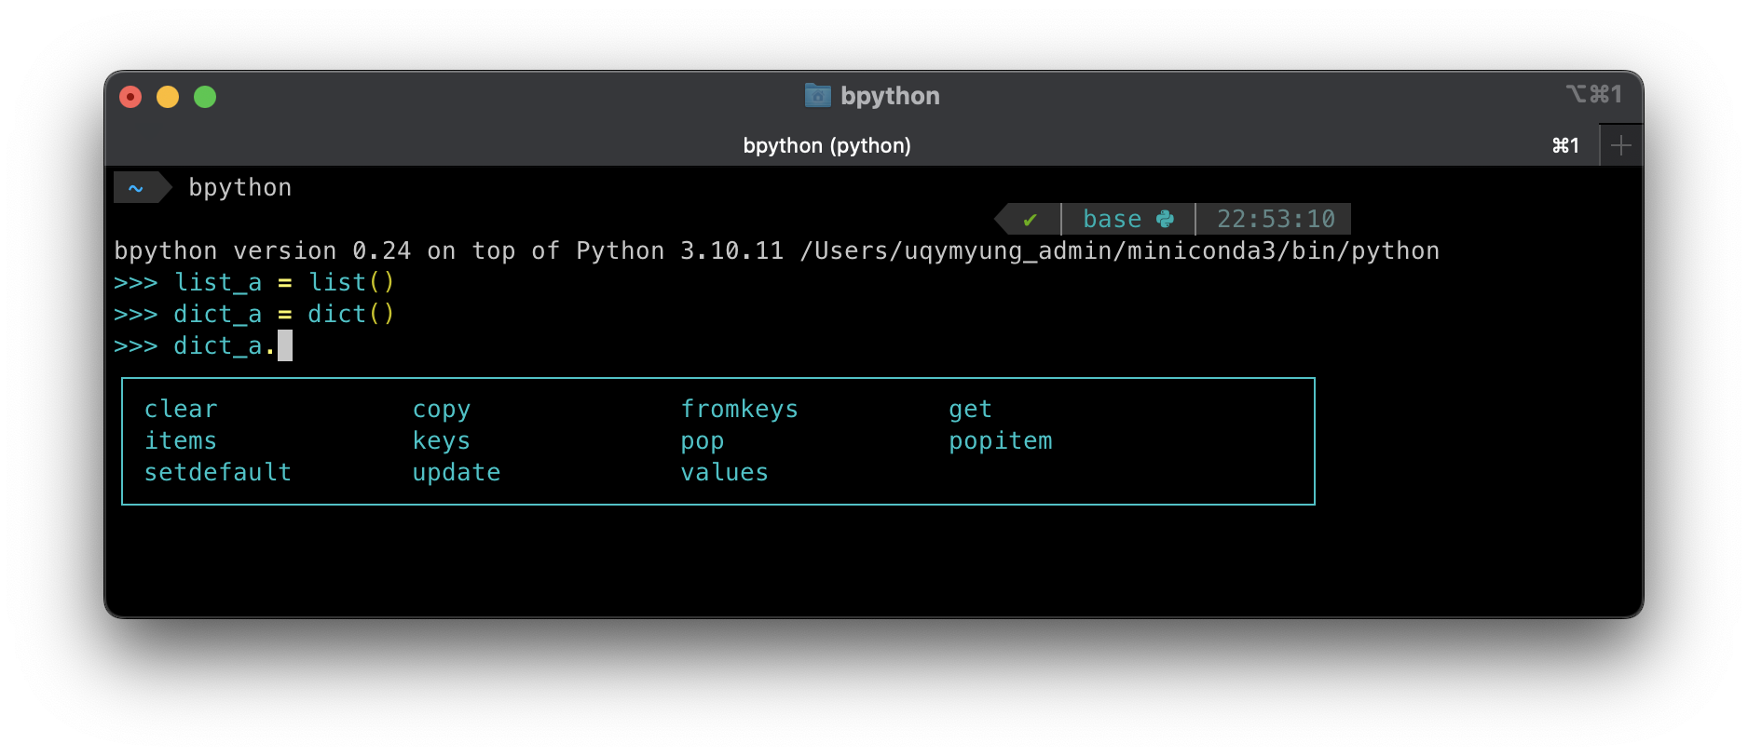
Dictionary
A mapping object maps hashable values to arbitrary objects.
key
value
keys
values
{‘ID-1’: ‘y.myung’, ‘ID-2’: ‘e.park’, ...}
{‘ID-1’: {‘name’: ‘Eric’, ‘age’: 24}, ...}
dict.keys(), dict.values() and dict.items() return the iterable of keys, values and items, respectively.
Q10. What happens if we add same keys?
Q11. What is difference between using slicing `[]` and `get()` method?

Slide 30
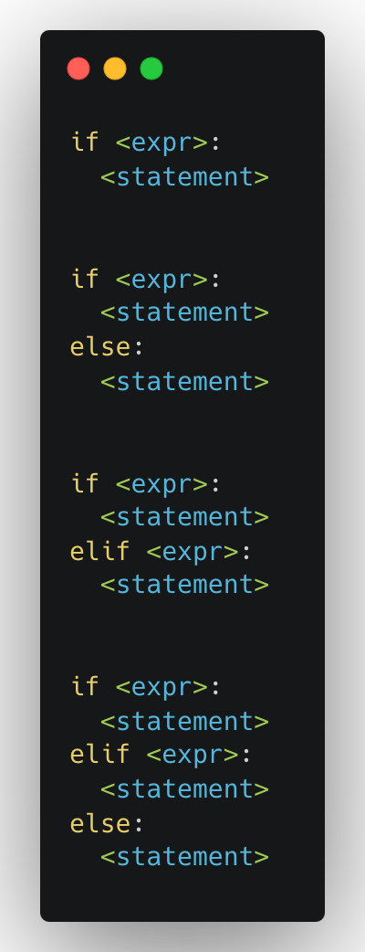
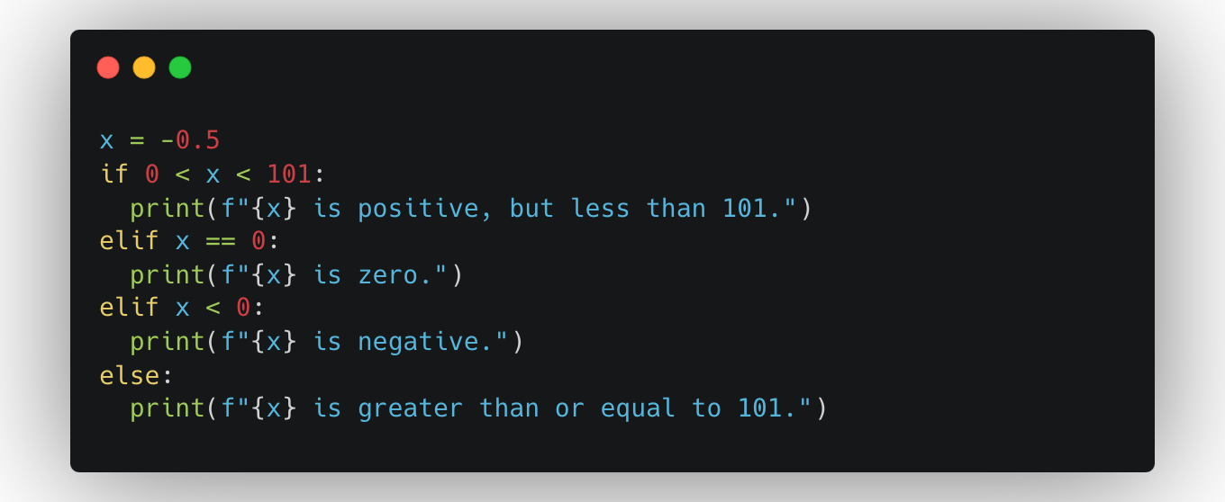
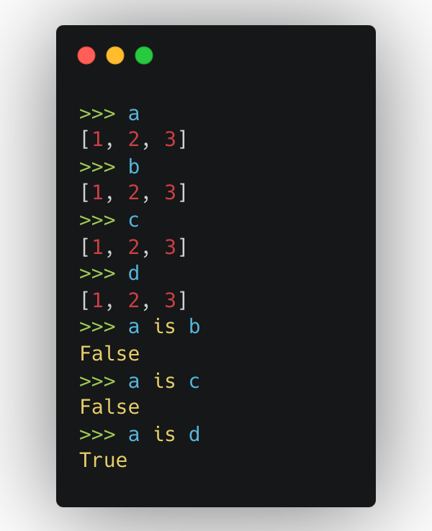
Compound statements
An essential part of the Python programming, which control the execution of other statements in some way.
[if, while, for, try, with, match, funcdef, classdef, async_with, async_for, async_func]
The `if` statement runs <statement> if the <expr> satisfies a condition.
Operation | Meaning
< | strictly less than
<= | less than or equal
> | strictly greater than
>= | greater than or equal
== | equal
!= | not equal
is | object identity (id)
is not | negate object identity (id)
Q12. Why the list ‘d’ is only identical to the list ‘a’?

Slide 31
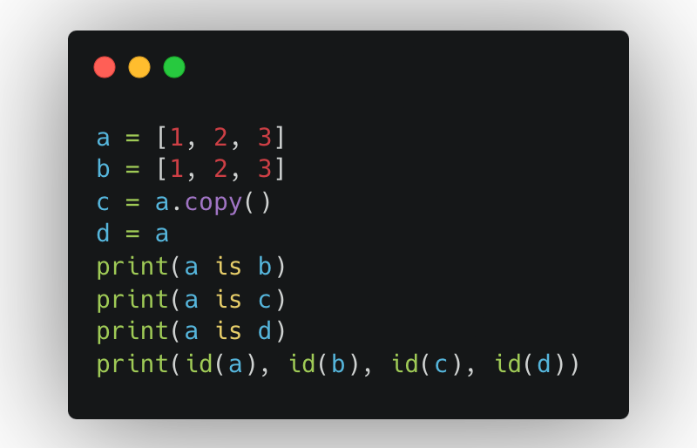
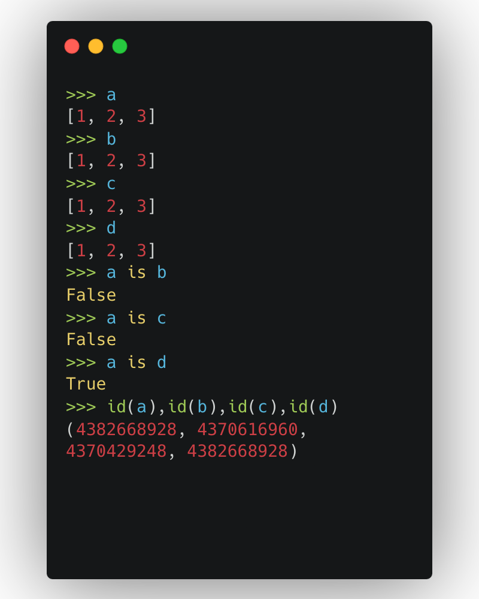
Compound statements, if
An essential part of the Python programming, which control the execution of other statements in some way.
[if, while, for, try, with, match, funcdef, classdef, async_with, async_for, async_func]
The `if` statement runs <statement> if the <expr> satisfies a condition.
Operator | Meaning
< | strictly less than
<= | less than or equal
> | strictly greater than
>= | greater than or equal
== | equal
!= | not equal
is | object identity (id)
is not | negate object identity (id)

Slide 32
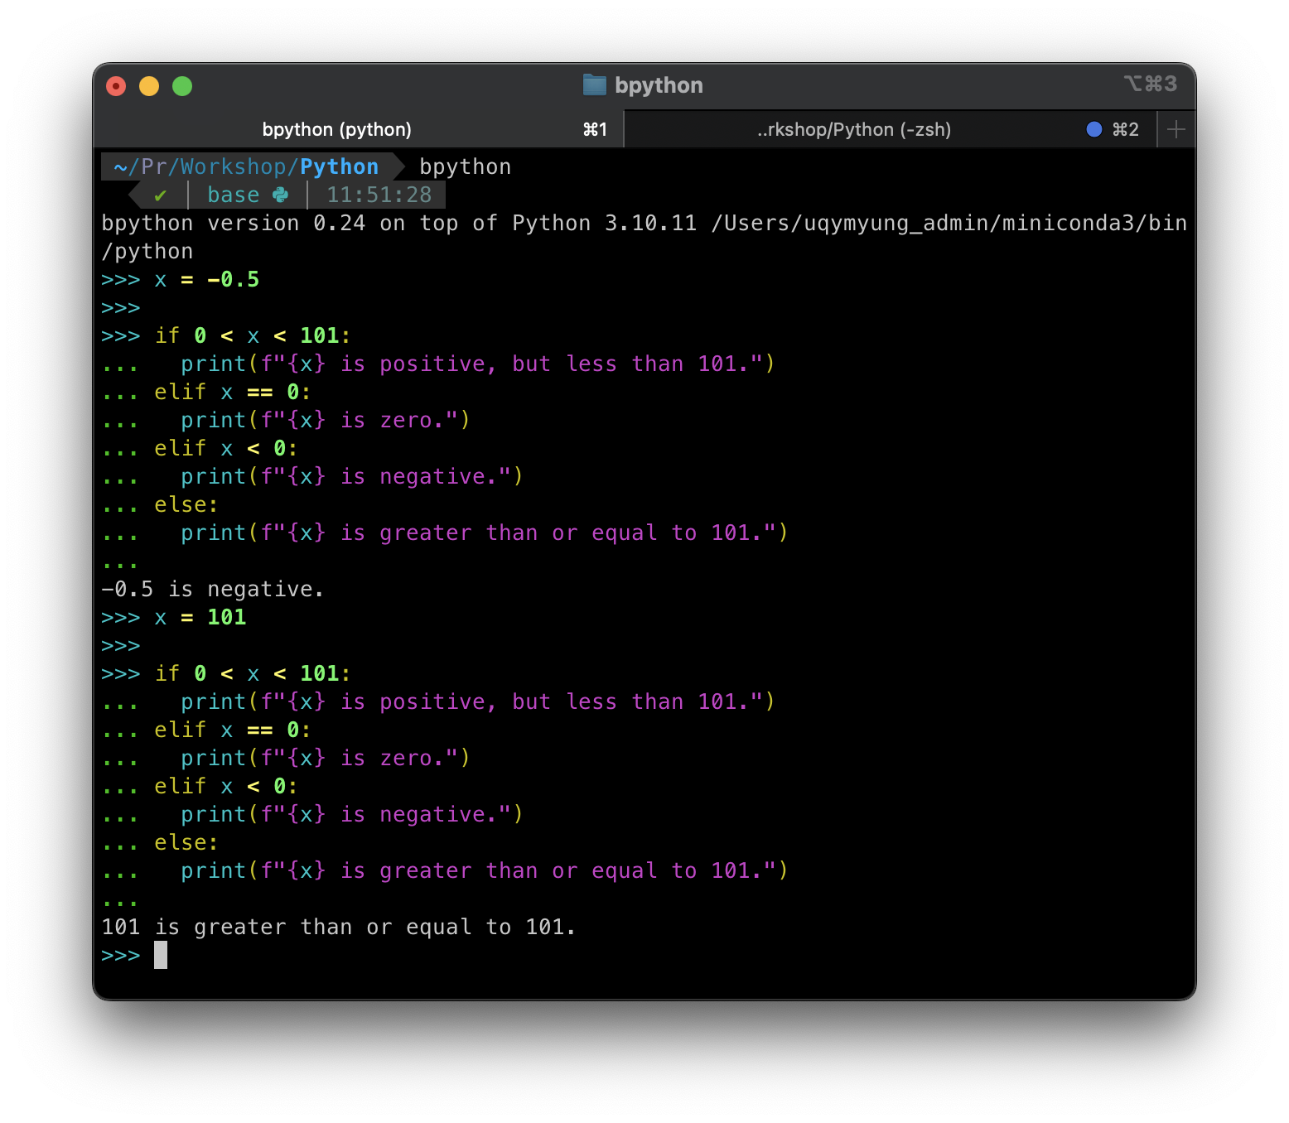
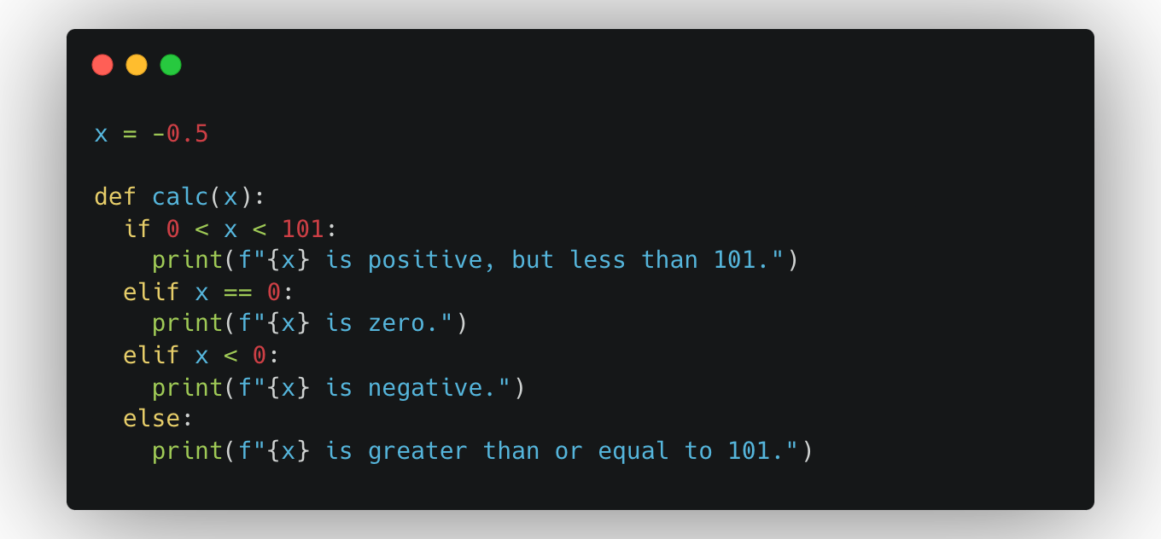
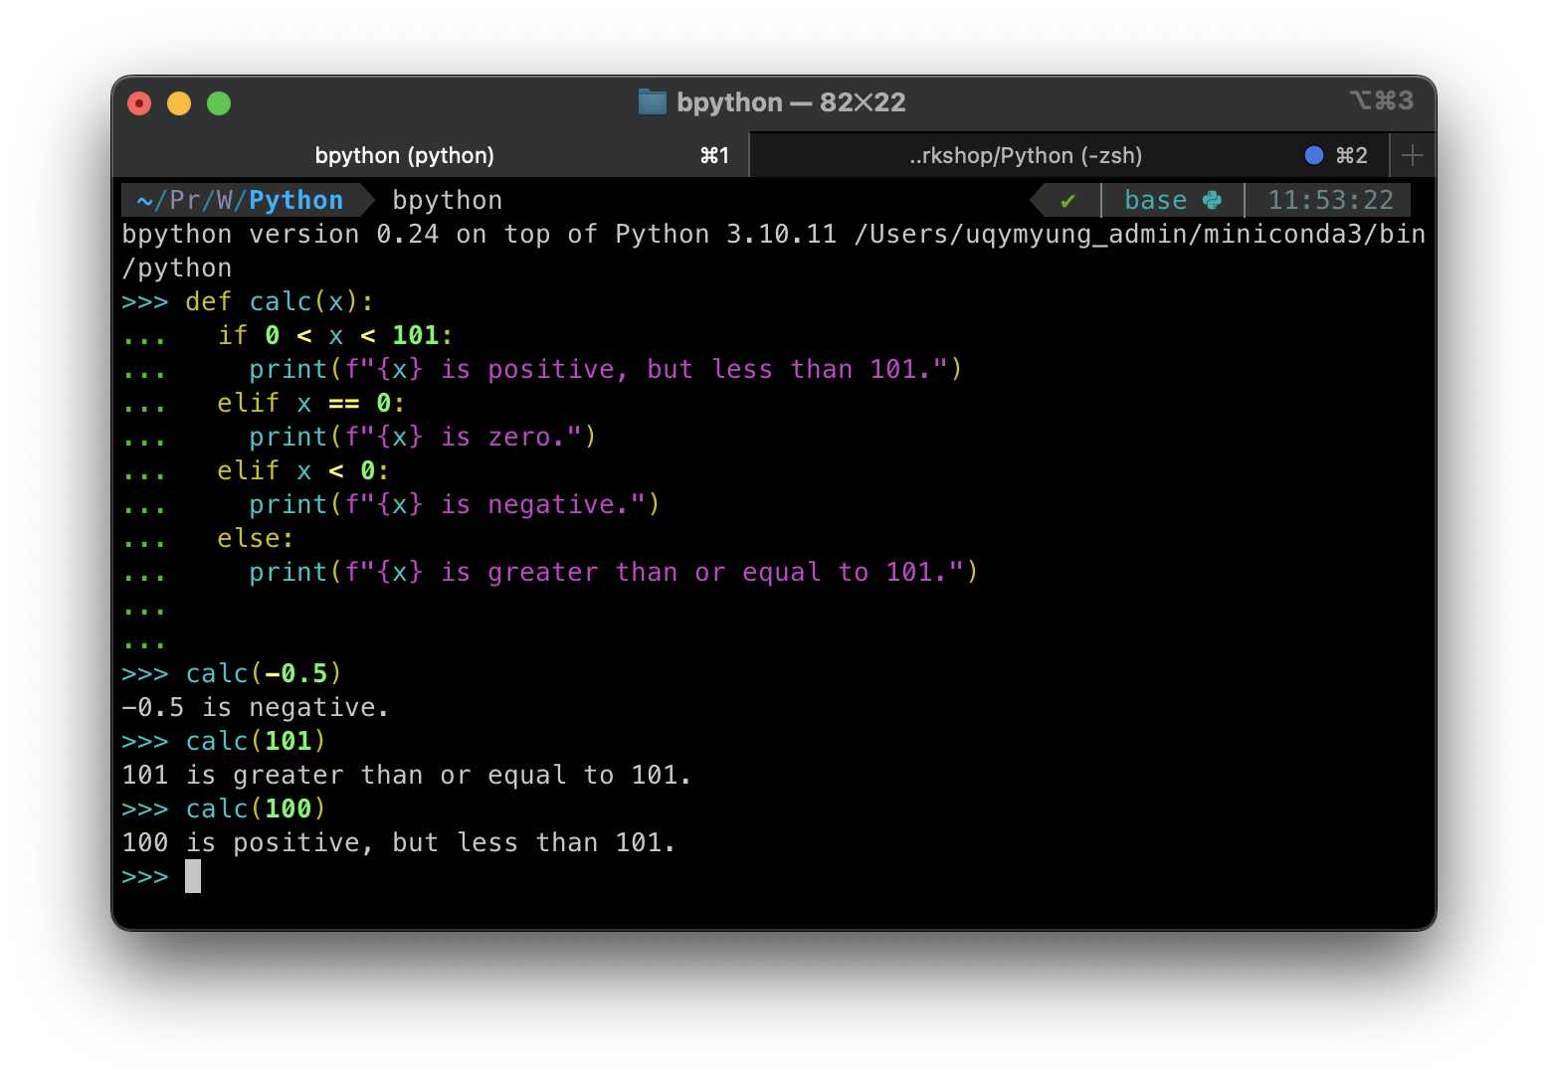
IF and Function

Slide 33
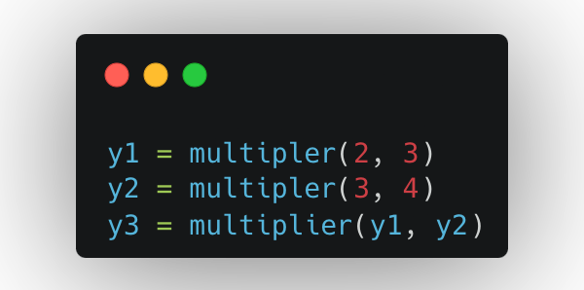
Function definitions
A function is an executable statement.
The function definition does not execute the function body; this gets executed only when the function is called.
name
parameter values
def multiplier(x1, x2):
y = x1 * x2
print(y)
return y
4 spaces
or
tab
Indentation Levels:
Indentation is used to denote nested blocks of code, such as loops, conditionals, and function definitions. Each nested block should be indented by one-level deeper than its parent block.

Slide 34
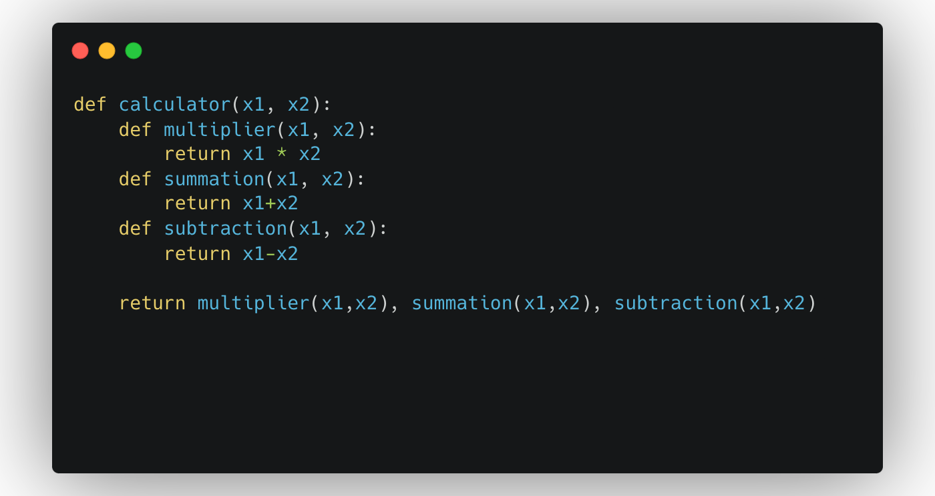
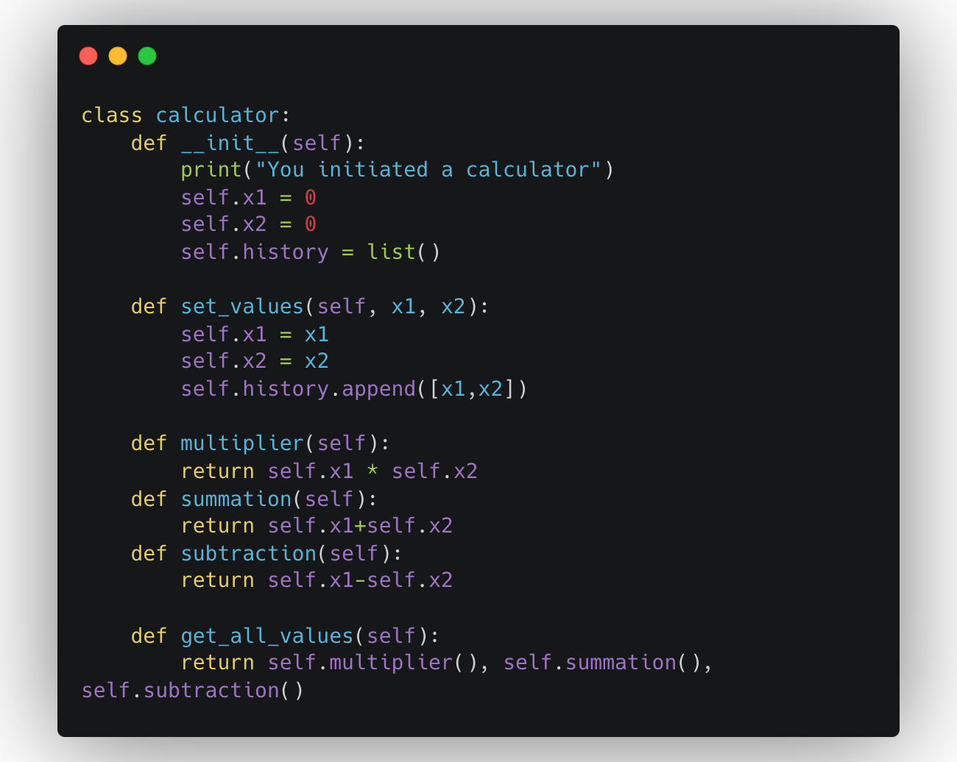
Function to Class
A class is an executable statement,
function
constructor
method
a class is a template for creating objects, while a function is a block of reusable code that performs a specific task

Slide 35
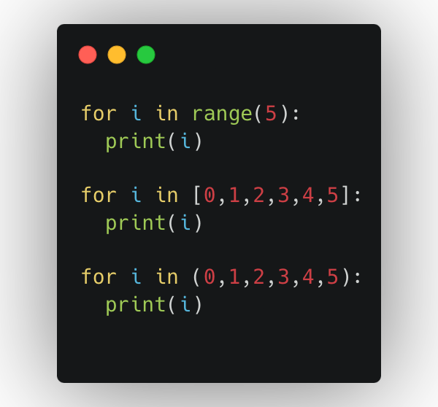
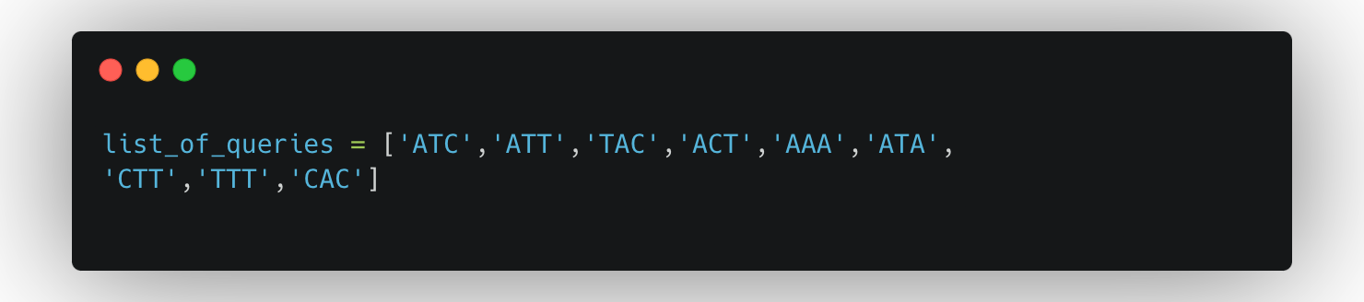
FOR statement
The `for` statement is used to iterate over the elements of a sequence or other iterable object.
A `break` statement executed in the first suite terminates the loop without executing
the `else` clause’s suite.
A `continue` statement executed in the first suite skips the rest of the suite and continues with the next item.
Q13. Given the list below, how can we retrieve a new list that contains only words starting with the letter “A”?

Slide 36
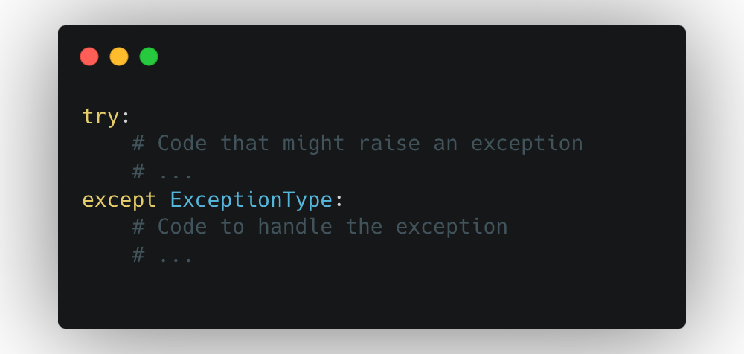
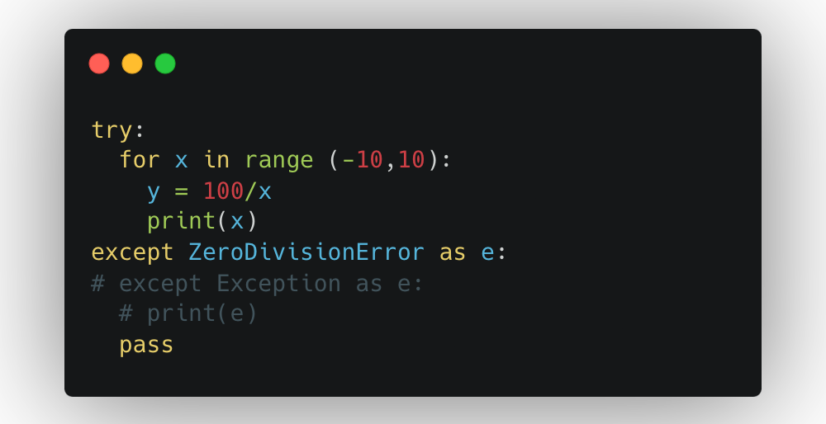
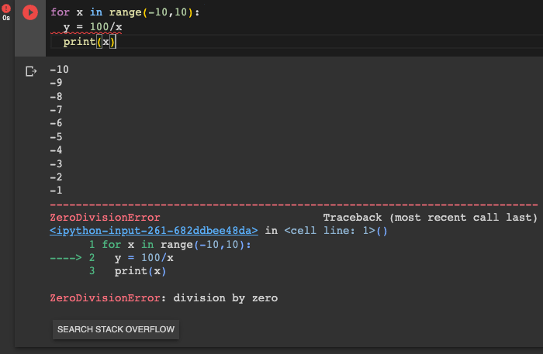
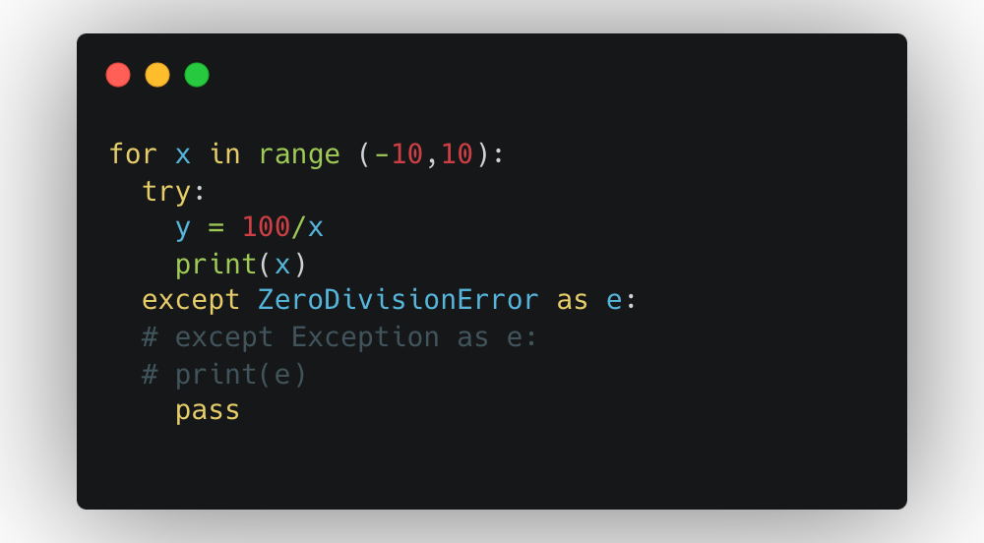
TRY / EXCEPT statement
Try and Except are used to implement exception handling, which allows you to manage and respond to errors or exceptional conditions that may occur during the execution of a program.
solution1
solution2

Slide 37
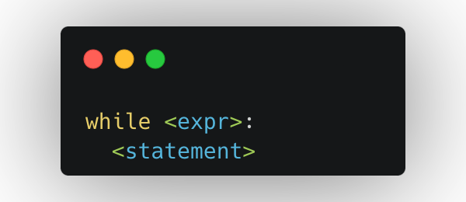
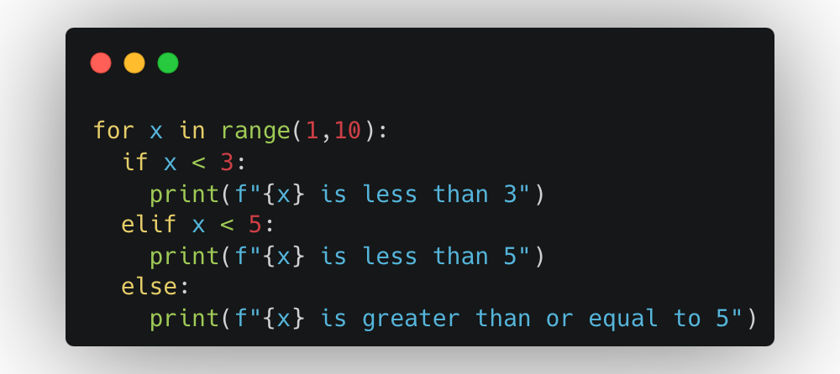
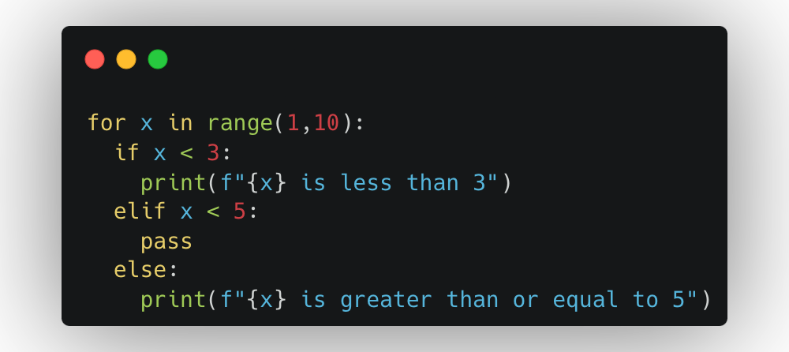
other statements
while: Indefinite iteration. Execute a statement repeatedly until a given condition is satisfied.
pass: The pass statement does nothing. It can be used when a statement is required syntactically but the program requires no action.

Slide 38
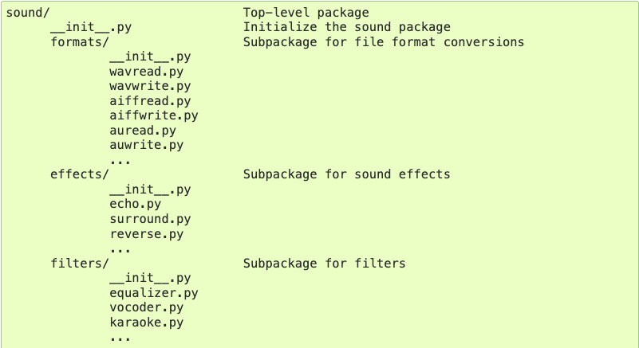



Modules and Packages
effects/echo.py
A module is a file containing Python definitions and statements.
The file name is the module name with the suffix .py appended.
Why we need to create a script?
> If you quit from the Python interpreter and enter it again, the definitions you have made (functions and variables) are lost. Therefore, if you want to write a somewhat longer program, you are better off using a text editor to prepare the input for the interpreter and running it with that file as input instead.
a.py
filters/equalizer.py
sound/a.py
sound/effects/echo.py
sound/effects/reverse.py

Slide 39

Standard Library
os: operating system interface, provides functions for interacting with the OS.
glob: provides a function for making file lists from directory searches.

Slide 40


Analysing Patient Data
Requirements: - a clinical trial inflammation data (csv); 60 arthritis patients for 40 days
- a library called NumPy, Numerical Python, for slicing and analysing data
Q14. How to get “MIN/MAX/MEAN/STD” per patient or per day across all days or all patients?
https://swcarpentry.github.io/python-novice-inflammation/instructor/02-numpy.html

Slide 41





Data Visualisation - Matplotlib
a popular Python library used for creating data visualisations.
- line plots, scatter plots, bar plots, histograms, pie charts and more.

Slide 42





Data Visualisation - Plotly
a Python library that allows for interactive data visualisation and provide wide range of graphing capabilities.

Slide 43


ChatGPT
ChatGPT is a language-based model designed for learning on sequential data.
Due to the temperature parameter, ChatGPT offers flexibility and creativity, resulting in potentially different answers over time. (use “regenerate response”)
#1 Writing Code and Generating data
#2 Debugging Code
#3 Converting Code
You need an openAI account for using ChatGPT.

Slide 44
ChatGPT
Temperature give flexibility and creativity.
What is ChatGPT? (1st try)
ChatGPT is a language model developed by OpenAI. It stands for "Chat Generative Pre-trained Transformer." It is built upon the GPT (Generative Pre-trained Transformer) architecture, specifically GPT-3.5, which is designed to generate human-like text based on the given input. ChatGPT can understand and generate natural language responses, making it useful for a wide range of conversational tasks and applications. It can be used to answer questions, provide explanations, assist with writing, simulate dialogue, and more.
What is ChatGPT? (2nd try)
ChatGPT is a language model developed by OpenAI. It is part of the GPT (Generative Pre-trained Transformer) family of models and is based on GPT-3.5 architecture. GPT-3.5 is a highly advanced and powerful language model that has been trained on a large corpus of text data from the internet. It can generate human-like text and respond to prompts in a wide range of topics and languages.
ChatGPT can understand and generate natural language, making it capable of engaging in conversations, answering questions, generating code, providing explanations, and much more. It has been designed to be versatile and useful in various applications, including customer service, content generation, language translation, and more. Users can interact with ChatGPT through API calls, integrating it into their applications, or by accessing it through platforms like ChatGPT website or other interfaces.

Slide 45
ChatGPT: Writing Python code
Q. Create a heatmap using Plotly based on some data (random).

Slide 46


ChatGPT: Writing Python code
Q: Can you write Python code to plot a heatmap with Plotly using some patient data?
brief explanation of the code
details about the code

Slide 47


ChatGPT: Writing Python code
Q: Can you create some patient data and apply to the above code?

Slide 48


ChatGPT: Writing Python code
Asking for Machine Learning examples

Slide 49


ChatGPT : Debugging

Slide 50

ChatGPT : Debugging
(1st try)
Q: Can you debug the following code?

Slide 51

ChatGPT : Debugging
(2nd try)
Q: Can you debug the following code?

Slide 52

ChatGPT : Debugging

Slide 53
Thank you
Yoochan Myung
Postdoctoral Research Fellow
y.myung@uq.edu.au
CRICOS 00025B • TEQSA PRV12080

